Slide 1
Updating your Group Record
in Time for the Holidays
Physical, Electronic, or Hybrid Meetings
Facilitator:
Area Group Records
Coordinator
Host:
New York South
Delegate
Presented Sunday, November 6, 2022
Notes:
This workshop took place on November 6, 2022.

Slide 2
Helping Newcomers Find Your Meeting
Ayudar a los recién llegados a encontrar su reunión
¿Estás listo para dar la bienvenida a los recién llegados esta temporada navideña? --In the Loop, octubre de 2022
Are You Ready to Welcome Newcomers this Holiday Season? – Oct 2022 -- In the Loop
Al-Anon Declaration
Declaración de Al-Anon
Let It Begin with Me
When anyone, anywhere,
reaches out for help, let the hand of Al-Anon and Alateen always be there and – Let It Begin with Me
Que empiece por me
Quando alguien, dondequiera que sea, pida ayuda, que nunca falte alli la mano de Al-Anon y Alateen, y –
Que empiece por me.
Notes:
Welcome! This NY South Area Workshop will cover the why, what, and how of maintaining group records.
Why maintain group records? With up-to-date meeting information, groups can most effectively carry Al-Anon's message to all who seek help for the family disease of alcoholism.
What kinds of meetings are there in today's reality? There are four different kinds, described below.
How to maintain group records? That is the purpose of the presentation to follow!

Slide 3
Four Types of Meetings
Cuatro tipos de reuniones
This Photo by Unknown Author is licensed under CC BY
Registered with WSO, meeting physically, may have electronic component;
Registered with WSO at a physical address, temporarily meeting electronically;
Electronic meeting originating from physical meeting, not meeting in the same room, time or day;
New permanent electronic meeting.
Registrado en la OSM, reunión presencial, puede tener componente electrónico;
Registrado en la OSM en una dirección presencial, reuniéndose temporalmente electrónicamente;
Reunión electrónica originada en reunión presencial, no reunida en la misma sala, hora o día;
Nueva reunión electrónica permanente.
Notes:
There are currently four types of Al-Anon meetings:
The first one is registered with World Service, meeting physically and may or may not have an electronic component
The second is registered with World Service at a physical address but is temporarily meeting electronically
The third type of meeting is an electronic one that originated from a physical meeting but is not meeting in the same room, time, or day
The fourth type of meeting is a new permanent electronic meeting.

Slide 4
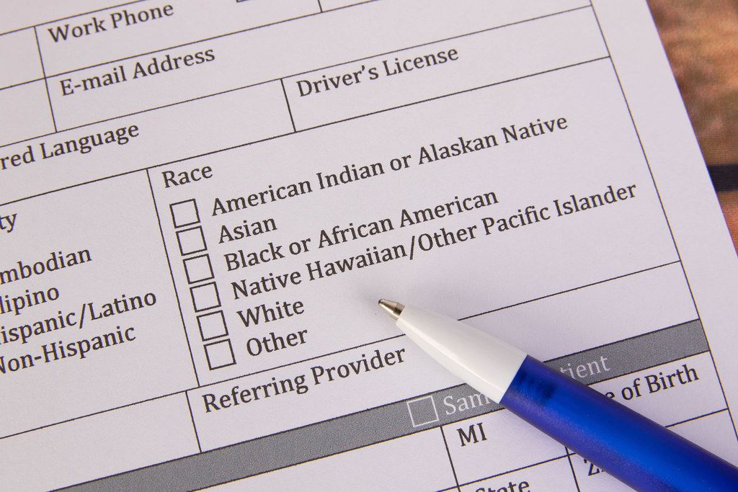
Is Your WSO Group Record Up-to-Date?
¿Está actualizado de registro de su grupo en WSO?
Why is this important?
¿Por qué es esto importante?
Newcomers often reach out first to WSO for help
Los recién llegados a menudo se comunican primero con OSM para obtener ayuda
It’s also good to update District, AIS and Intergroup listings
También es bueno actualizar
los listados de distrito,
SIA y intergrupo
Notes:
In the October 2022 issue of In the Loop, there was an article called, “Are you ready to welcome newcomers this holiday season?”
The article asked, “Is your World Service Group record up to date?” and “Why is this important?” That's because newcomers often reach out first to World Service for help. So even if your group is listed on district, AIS or Intergroup sites, it's very important to also update your record with World Service. So how do we do that?

Slide 5
Locating Your WSO Group Record
<al-anon.org> (WSO website)
Members Tab
AFG Records
https://al-anon.org/al-anon-meetings/find-an-al-anon-meeting/
Notes:
First: go to the WSO website: al-anon.org. Click on the Members tab and select AFG Records. The link for AFG Records is also shown at the bottom of this slide.

Slide 6
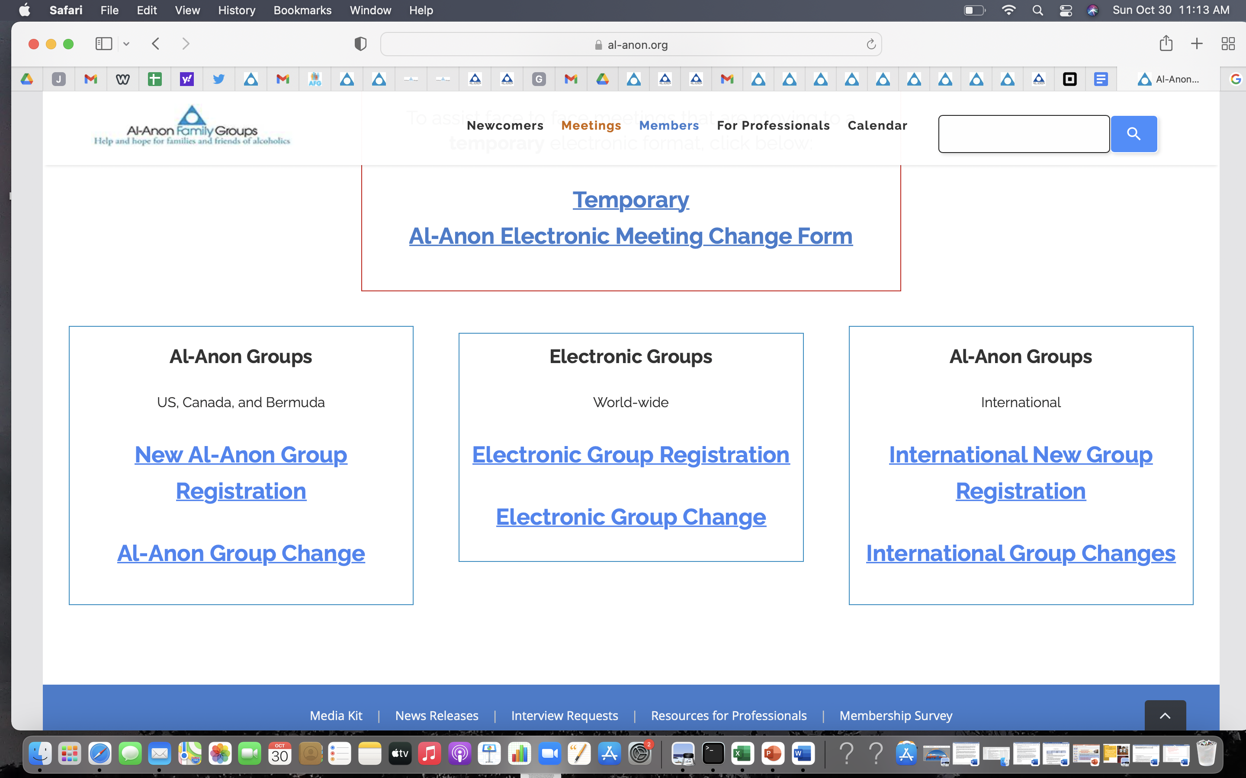
Notes:
You will then find yourself on this page, where you can register a new meeting or make a change to an existing meeting, whether physical, hybrid or electronic, temporary or permanent. We’ll come back to this in a few minutes.

Slide 7
Updating your Group Record
depends on how your group is meeting
La actualización del registro de grupo
depende sobre cómo se reúne su grupo
Notes:
In short, updating your group record depends on how your group is meeting. Next, we’ll go through the four types of meetings again, and this time, briefly outline how to update the group record for each one.

Slide 8
Updating Group Registration
According to Meeting Type
Actualización del registro de grupos
según el tipo de reunión
Registered with WSO at a physical address, meeting physically,
with or without electronic component:
Update may include: Adding electronic platform info in LOCATION box on WSO Group Record
Registrado en OSM en una dirección física, reunión presencial,
con o sin componente electrónico:
La actualización puede incluir: Agregar información de la plataforma electrónica en el cuadro UBICACIÓN en el registro del grupo OSM.
Notes:
In the first example, a group is registered with World Service at a physical address and is meeting physically with or without an electronic component. The way to update it may include adding the electronic platform information in the location box on the WSO group record. (You can either do that electronically, or download a group change form and mail it in.)

Slide 9
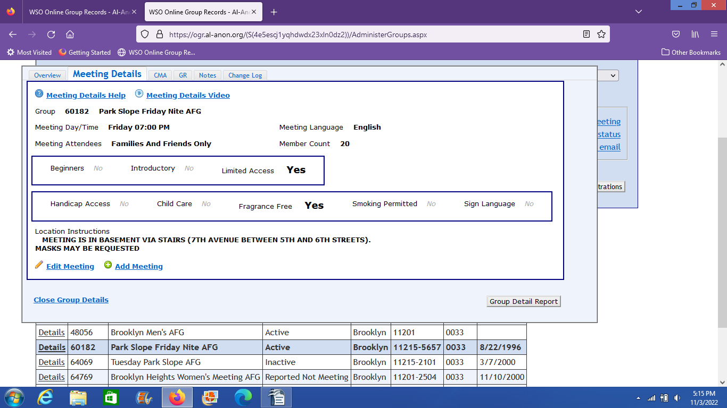
Notes:
Here’s an example of a physical group record.
See the Location Instructions Box? That’s where a physical meeting with an electronic component can add instructions for members joining electronically.

Slide 10
Updating Group Registration
According to Meeting Type
Actualización del registro de grupos
según el tipo de reunión
2) Registered with WSO at a physical address, temporarily meeting electronically
Update: Fill out Temporary Al-Anon Electronic Meeting Change form
2) Registrado con OSM en una dirección física, reuniéndose temporalmente electrónicamente
Actualización: Llene el formulario de cambio de reunión electrónica temporal de Al-Anon
Notes:
The second type of group is registered with WSO at a physical address but is temporarily meeting electronically. The way to update your record is to fill out a temporary Al-Anon electronic meeting change form. The reason this is particularly important is that newcomers may go to the WSO listing, take down the physical address, try to attend the meeting, and find that the door is locked. So it's very important if you're meeting temporarily electronically to update your record with WSO.

Slide 11
Notes:
Back to the AFG Records landing page: Here you would click on Temporary Al-Anon Electronic Meeting Change Form.

Slide 12
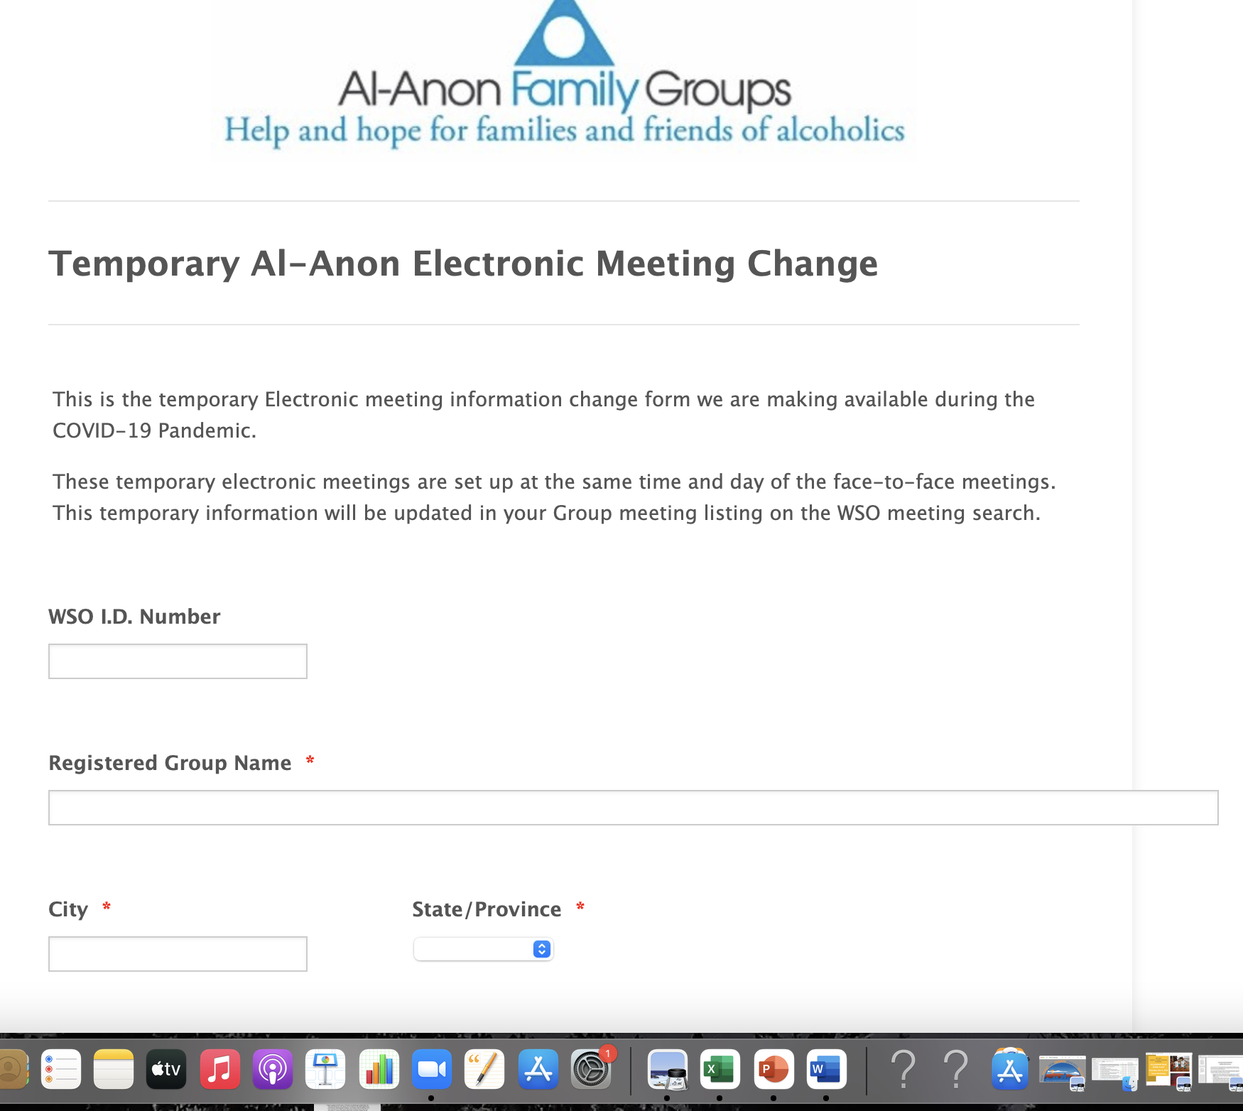
Notes:
This is the page that opens up. You’ll be asked for your WSO ID Number, your registered group name, etc.
So, how do you find this information?

Slide 13
Locating your WSO Registration Number
<al-anon.org>
Members Tab
Meetings Tab
Find a Meeting
Notes:
Go back to the Members tab, click on Meetings and select “Find a Meeting.”

Slide 14
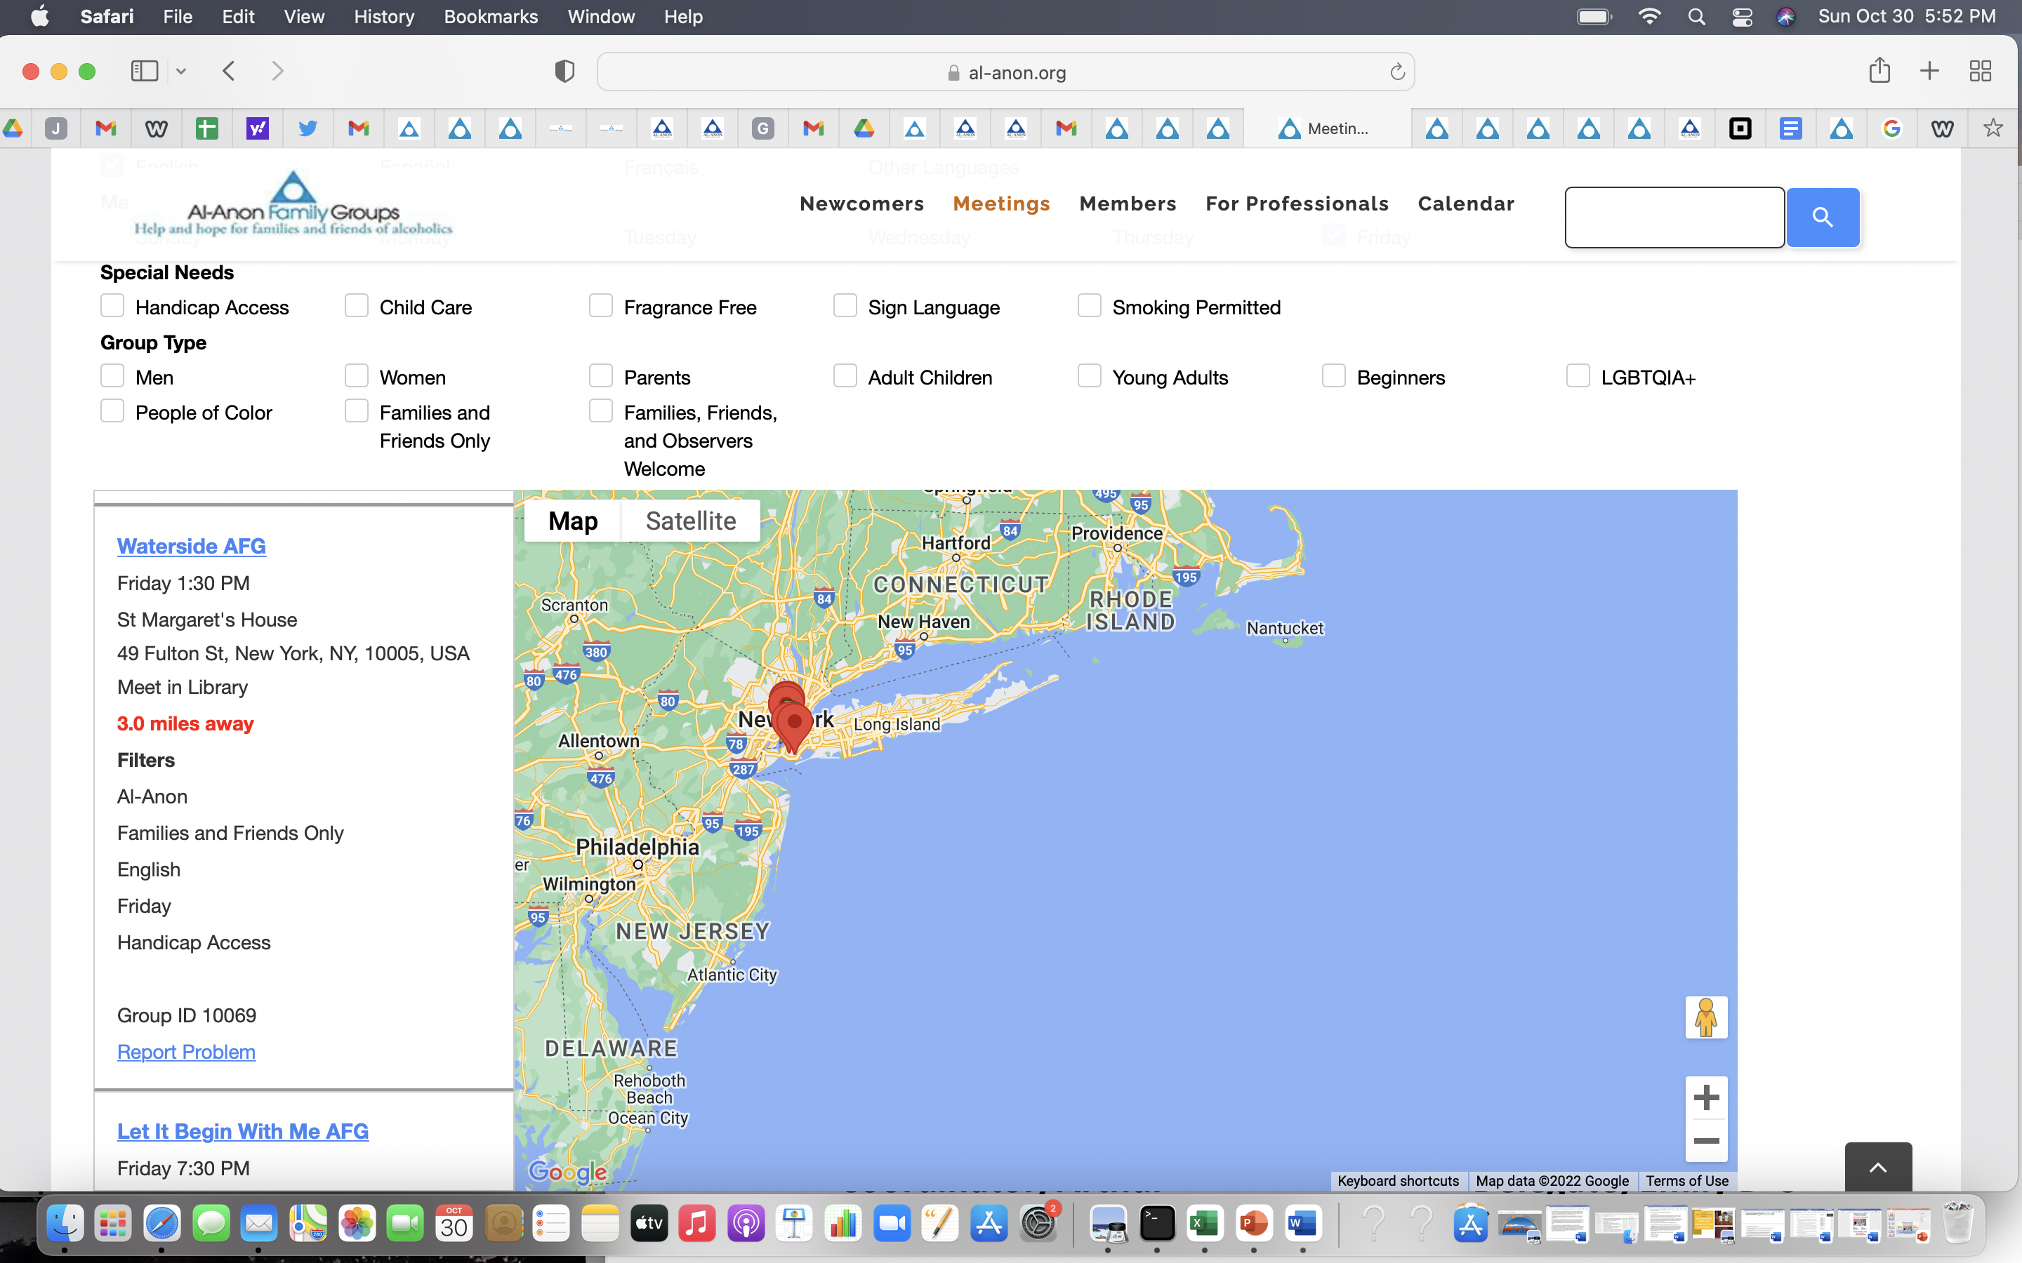
Notes:
A page like this will come up. Here you can select a location (5 or more miles from your house) or a zip code, and a list of meetings will be shown. When you find your meeting, the WSO ID number will be listed.

Slide 15
Updating Group Registration
According to Meeting Type
Actualización del registro de grupos
según el tipo de reunión
3) Electronic meeting originating from physical meeting, not meeting in the
same room, time or day;
Update: Register as a new meeting with WSO
3) Reunión electrónica originada en reunión presencial, no reunida en la misma sala, hora o día;
Actualización: Regístrese como una nueva reunión con la OSM
Notes:
The third type of meeting is an electronic meeting that originated from a physical meeting, but is not meeting in the same room, time or day. The way to update it is to register as a new electronic meeting with WSO.

Slide 16
Updating Group Registration
According to Meeting Type
Actualización del registro de grupos
según el tipo de reunión
4) New permanent electronic meeting.
Update: Register as a new meeting with WSO
4) Nueva reunión electrónica permanente.
Actualización: Regístrese como una nueva reunión con la OSM
Notes:
The fourth type of meeting is a new permanent electronic meeting, and the update is the same as in the last example: Register as a new meeting with WSO.

Slide 17
Notes:
How to do this: Return to the AFG Records landing page: click on Electronic Group Registration

Slide 18
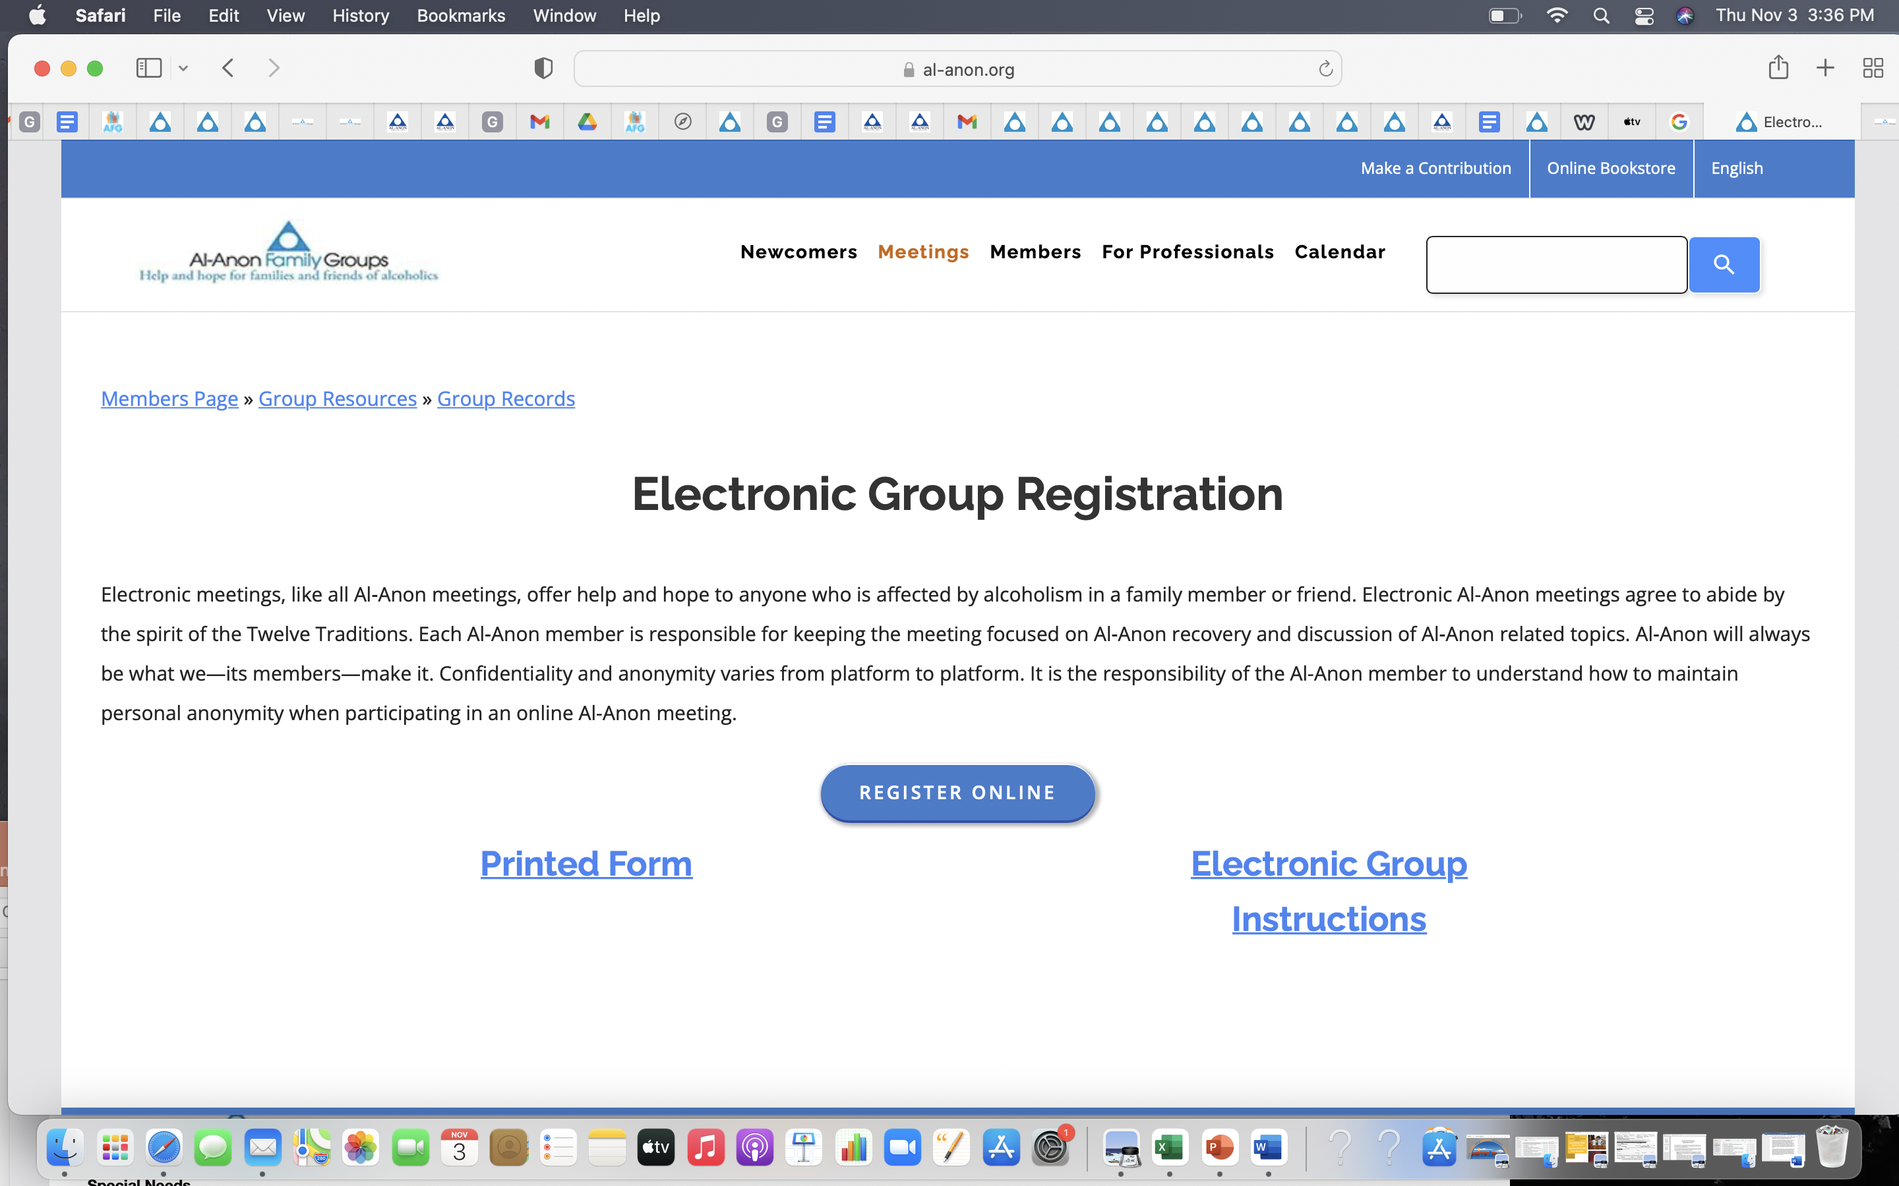
Notes:
This is the page that comes up. Follow the Electronic Group Instructions to register your group as a permanent electronic meeting.

Slide 19
Notes:
By clicking Instructions, you’ll be walked through each section of the registration form.

Slide 20
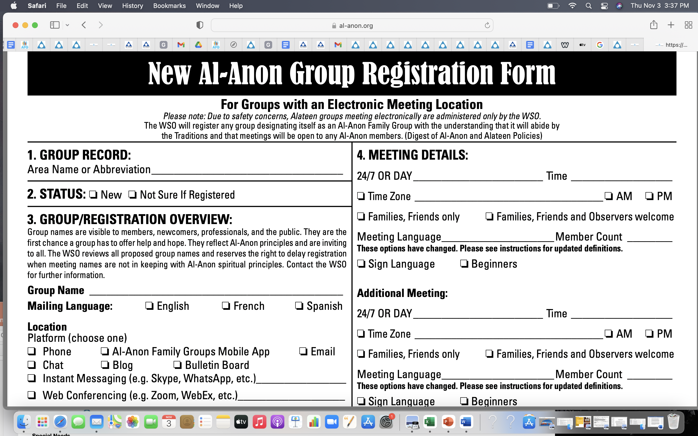
Notes:
You can also download the registration form, fill it out, and mail it back to WSO.

Slide 21
Global Electronic Area or New York South?
Al-Anon’s Links of Service
I. As a new electronic meeting,
your group
will be automatically assigned to the Global Electronic Area (GEA)
II. If, and when, New York South Group votes to accept electronic meetings into our Area, your group may ask to leave the GEA and join
New York South.
Notes:
A closing note about Al-Anon’s Links of Service. In 2021, the Global Electronic Area (GEA) was created to house all electronic Al-Anon groups. In April 2022, the World Service Conference voted to accept the new GEA into the Conference, and to seat the newly-elected Delegate.
Once you register as a new electronic meeting, your group will be assigned to the GEA. If, and when, NYSA votes to accept electronic meetings, your group can then petition the GEA and New York South to leave the GEA and join our geographic Area.

Slide 22
Please contact
your District
Representative,
Area Group Records
Coordinator, or
Delegate.
Por favor, póngase en contacto con su Distrito Representante, Coordinator de rehistros
de groupos, o Delegada.
Any Questions?
Alguna Pregunta?
Notes:
If there are other questions, please contact your District Representative, Area Group Records
Coordinator, or Delegate.

