Slide 1
Emily D-C Panel 60 Delegate New York South Area Emily D-C Delegada del Panel 60 Sur de Nueva York nys60delegate@gmail.com
61st World Service Conference 61.a Conferencia de Servicio Mundial
April 12 – 16, 2021
12 al 16 de abril de 2021
Notes:
1. The 61st World Service Conference took place virtually from April 12-16th of this year.
In this report, I’ll try to give you a feel for what Conference was like, cover some important discussions and decisions that were made, and share with you some news and announcements. I’ll pause twice during my report for questions, and once at the end. Before lunch, we’ll have a breakout session to talk about your virtual, hybrid and face-to-face meetings.
For any follow-up questions, please e-mail me: nys60delegate@gmail.com (:45)

Slide 2
My Seat at the 2021 World Service Conference Mi Asiento en la Conferencia de Servicio Mundial 2021
Wall of greeting cards
by my computer
during Conference
Muro de tarjetas de felicitación junto a mi computadora durante la conferencia
Notes:
2. This photo shows where I sat during Conference week. These were long days and nights, and I was so grateful for the support of our Area in the form of e-mails, cards, snacks, and love gifts. (:15) {Running total: 1.00}

Slide 3
So What Happened at Conference? Entonces, ¿qué pasó en la Conferencia?
Twelve International Guests
Doce Invitados Internacionales
Fifteen motions and votes Quince mociones y votaciones
Notes:
3. So what happened at Conference this year?
Because of the virtual format we had twelve international guests from all around the world (usually there are only two). It was a joy to hear them share their experience, strength and hope and to see the commitment of those, like the Australian representative, who logged on at 1:00 am every morning and stayed through the night until we ended at 9:30 am Australia time.
During Conference, we entertained a total of fifteen motions. They’ll be published in the 2021 WSC Summary, online in July. Some motions were routine, like the seating motion, the Audit, Budget, and the Annual Report. Other motions were groundbreaking and historic. I’ll get to those now: (1:00) {Running total: 2:00}

Slide 4
Two Historic Proposals by the Electronic Meeting Work Group Dos Propuestas Históricas del Grupo de Trabajo de Reuniones Electrónicas
Notes:
4. The electronic meeting work group (EMWG) is comprised of WSO staff and volunteers. After the 2020 WSC, they met biweekly to grapple with the question of whether and how to incorporate permanent electronic meetings into our World Service Conference structure.
A year ago, there were 300 registered electronic groups, which included: telephone, video conferencing, e-mail and chat. Now there are 450 groups, which account for 700 electronic meetings.
Up until now, none of these meeting has had a group rep. Through their CMAs, electronic meetings were represented at Conference by the Assoc. Director of Group Services. Many members have wanted electronic groups to be represented by their own Delegate in their own Area.
In April, it finally came time to see if we were ready to make this momentous change. (1:20) {Running total: 3.20}

Slide 5
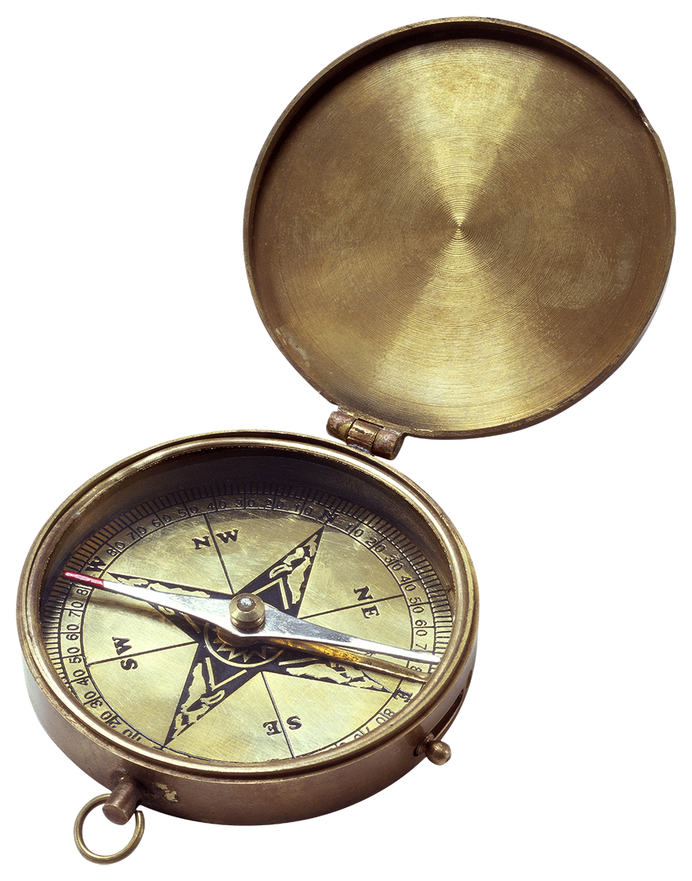
Motions 6 & 7 Pass Pasan las Mociones 6 y 7
To create a non-geographically based Area for the 450 groups (700 meetings) that meet on electronic platforms.
Crear un Área de base no geográfica para los 450 grupos (700 reuniones) que se reúnen en plataformas electrónicas.
To recognize permanent electronic meetings as
Al-Anon Family Groups
Reconocer las reuniones electrónicas permanentes como Grupos de Familia Al-Anon
Notes:
5. First, we discussed two proposals from the EMWG:
1) To create a non-geographically based Area for the 450 groups (700 meetings) that meet on electronic platforms.
2) To recognize permanent electronic meetings as Al-Anon Family Groups
After two hours of discussion on two different days WSC members finally voted:
The first Motion passed 87 to 2; The second Motion passed 88 to 0: (It was unanimous!)
Both decisions will allow electronic groups and their new virtual Area to elect all positions identified in the Service Manual, including Group Representatives (GRs), District Reps, Area Coordinators, Officers, and a Delegate.
For me, this was the most exciting moment of Conference this year. It’s truly a groundbreaking and historic change for our fellowship. We’re embracing the reality that our members find recovery regardless of where they live, and now they’ll have a voice and vote at Conference by their elected representative. (1:30) {Running total: 4:50}

Slide 6
What Happens in 2021-22? ¿Qué ocurrirá en 2021-22?
All permanent electronic AFGs are placed in Electronic Area
Todos los AFG electrónicos permanentes colocados
en el área electrónica
2. At virtual Assembly, GRs elect officers and Delegate
En la asamblea virtual, los RR.GG. votarán por
los oficiales y elegirán Delegados.
3. 2022 World Service Conference: Electronic Area requests
recognition and new Delegate is seated with voice & vote
Conferencia de Servicio Mundial 2022: El Área Electrónica solicita reconocimiento y el nuevo Delegado puede tomar asiento con voz y voto
First Things First
Lo primero es
lo primero
Notes:
6. So what happens now?
Every permanent electronic AFG will be automatically placed in an Electronic Area.
The virtual groups will propose a slate of officers and schedule a virtual Assembly where newly elected GRs will vote on officer positions and elect their own Delegate.
At the 2022 World Service Conference, the Virtual Area may ask to be officially recognized as our 68th WSC Area, and request that their new Delegate be seated with voice and vote. (:45)
{Running total: 5:35}

Slide 7
Implications for New York South Implicaciones para el Sur de Nueva York
New York South Area has a year to decide whether to accept electronic meetings into our Area should a meeting request it.
El Área Sur de Nueva York tiene un año para decidir si acepta reuniones electrónicas en nuestra Área en caso de que una reunión lo solicite.
Notes:
7. If the Electronic Area is recognized by the 2022 World Service Conference, individual electronic groups may then ask to move to a geographic Area. It will be up to both the electronic Area and the geographic Area to approve this change.
Actions for New York South between now and the next Conference
We have at least a year to consider whether New York South wants to accept electronic meetings into our Area should they request it. The AWSC may consider some parameters and work out what our Area process would be. (:50) {Running total: 6:25}

Slide 8
Tradition Two & Warranty Three in Action Tradición Dos y Garantía Tres en Acción
KBDM (Knowledge-Based Decision-Making) Process
Toma de decisiones basada
en el conocimiento
Framing document
Documento enmarcado
2) Discussion
Discusión
3) Consensus to create motion
Consenso para crear movimiento
4) Discussion of motion
Discusión de movimiento
5) Vote
Votar
6) Minority Opinion Entertained
Opinión de la minoría entretenida
7) Decision Accepted by all
Decisión aceptada por todos
Photo by Blanca R. / Foto de Blanca R.
Notes:
8. I want to take a moment to talk about the process we went through to make this decision.
Remember the KBDM Coffee Pot exercise we did in March?
I don’t think I’m alone in feeling confused about whether and how to use motions when following KBDM. But this year’s Conference cleared up my confusion. I’d like to explain it to you. But first, can I have three people volunteer to read Tradition Two, Warranty Three, and Concept Five? (I may ask people ahead of time.)
Thank you all.
During Conference, we voted on fifteen different motions. For most of them, we were guided through seven steps before the decision was made.
First, we moved from a presentation of a framing document, which included background information on the proposal. Then there was a timed discussion--usually 30-60 mins. After that, the Chairperson asked for a consensus or group conscience on whether we were ready to create a motion. If yes, a motion was prepared and read to us. Sometimes there was discussion on the wording. And finally a vote was taken—and it was usually close to unanimous. Afterwards, the Chairperson might ask those who voted No to express their reasons, and see whether any Conference member wished to change their vote.
Throughout this sometimes lengthy process, it was inspiring to see Tradition Two, Warranty Three, and Concept Five in action!
( Before we go to the next slide, I want to point out the beautiful photo by Blanca R.)
(2:30) {Running total: 8:55}

Slide 9
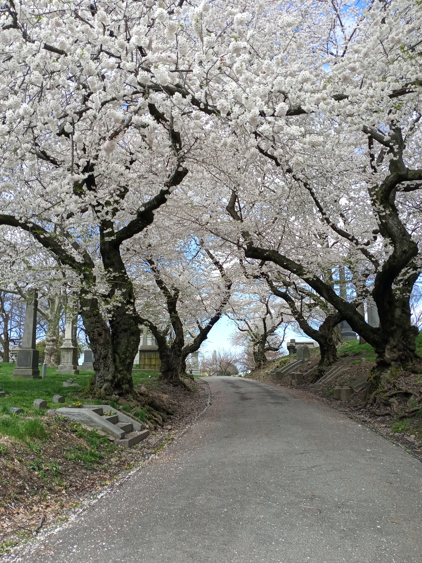
Some Important Decisions Algunas Decisiones Importantes
Interpretation
Interpretación
Literature
Literatura
Longitudinal Members’
Study
Miembros Longitudinales Estudio
Notes:
9. Here are some important decisions that were made using the KBDM process I just described:
It began with language interpretation at the WSC:
After a three-year trial funded by WSO, members voted to continue offering interpretation in Spanish and French at the WSC so Areas can elect the best Delegate regardless of language. WSO won’t be able to budget for this added expense without cutting salaries or other essential services. After much discussion, members voted to fund interpretation costs through the Full Amount or the Equalized Expense paid by each Area. (:50) {Running total: 9:45}

Slide 10
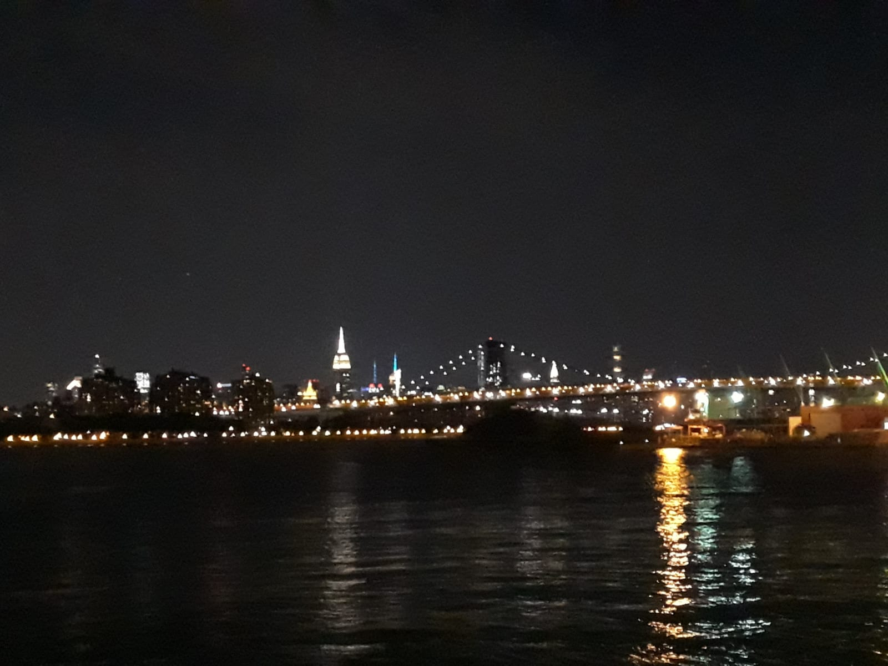
Literature Committee Motions & Votes Mociones y Votos del Comité de Literatura
Alateen Materials
Materiales de Alateen
Just for Tonight Bookmark for Alateen
Marcador Solo Por Esta Noche para Alateen
Alateen Preamble Updated (Policy Committee)
Preámbulo de Alateen actualizado
(Comité de Políticas)
{Photo by Blanca R. / Foto de Blanca R.}
New Introductions / Nuevas presentaciones:
One Day at a Time in Al-Anon (B-6)
Un Día a la Vez en Al-Anon
The Dilemma of the Alcoholic Marriage (B-4)
El Dilema del Matrimonio Alcohólico
Notes:
10. The Literature Committee offered four motions this year.
1. Conceptual approval was given to the Committee to develop a “Just for Tonight” bookmark with sharings from Alateen members.
2. Approval for a revised Alateen Preamble was also given. The preamble will be updated in all Conference Approved Literature (CAL), and included in the 2022-2025 Al-Anon/Alateen Service Manual. It currently appears in the Conference Highlights under the Members tab at al-anon.org.
3. Conceptual approval was given to the Literature Committee to add a new introduction that will place two of our older books in their historical perspective: the ODAT One Day at a Time in Al-Anon, and The Dilemma of the Alcoholic Marriage
4. Likewise, conceptual approval was given to the Committee to create a booklet of gems from The Dilemma of the Alcoholic Marriage.This book continues to be valued by many of our members. (1:15) {Running total: 11:00}

Slide 11
Any Questions? ¿Alguna pregunta?
Before continuing, let’s take
a few minutes for questions.
Antes de continuar, dediquemos
unos minutos a las preguntas.
Please use the raised hand
function in the chat.
Miembros españoles, por favor
escriba sus preguntas en el chat
Notes:
11. Before continuing with my report, we can take a few minutes for questions. English members, please use the raised hand function in the chat and I’ll call on you. Spanish members can type your questions into the chat and we’ll have them translated.
(:20) (Up to 8 mins for questions){Running total: 19:20}
(Click)

Slide 12
Two Minute Break Descanso de Dos Minutos
Photo by Debbe / Foto de Debbe
Notes:
12. Now we’ll take a two-minute break for the interpreters. When we return, we’ll move into the budget and finance portion of my report.
I hope you enjoyed this lovely photograph by Debbe. (:15) {Running total: 21:35}

Slide 13
Assembling Love Gifts at my Kitchen Table Armar Regalos de Amor en la Mesa de mi Cocina
Postcard from New York South
Postal del Sur de Nueva York
Postcard from Spanish Group
Postal de Solo Por Hoy
Bookmarks from Suffolk groups and Districts 4, 5, 6
Marcadores de grupos de Suffolk y los distritos 4, 5, 6
Slogan sticks from District 10
Palos de eslogan del
Distrito 10
Wooden slogan “coins” from District 33
Lema de madera "monedas" el Distrito 33
Notes:
13. Thanks to the generosity of our members, groups, and districts I was able to mail NYS greetings and love gifts to all the Delegates and WSC Members. This happened before, during, and after Conference, at my kitchen table.
Now we’ll turn to the WSO budget and finance report. (:20) {Running total: 21:55}

Slide 14
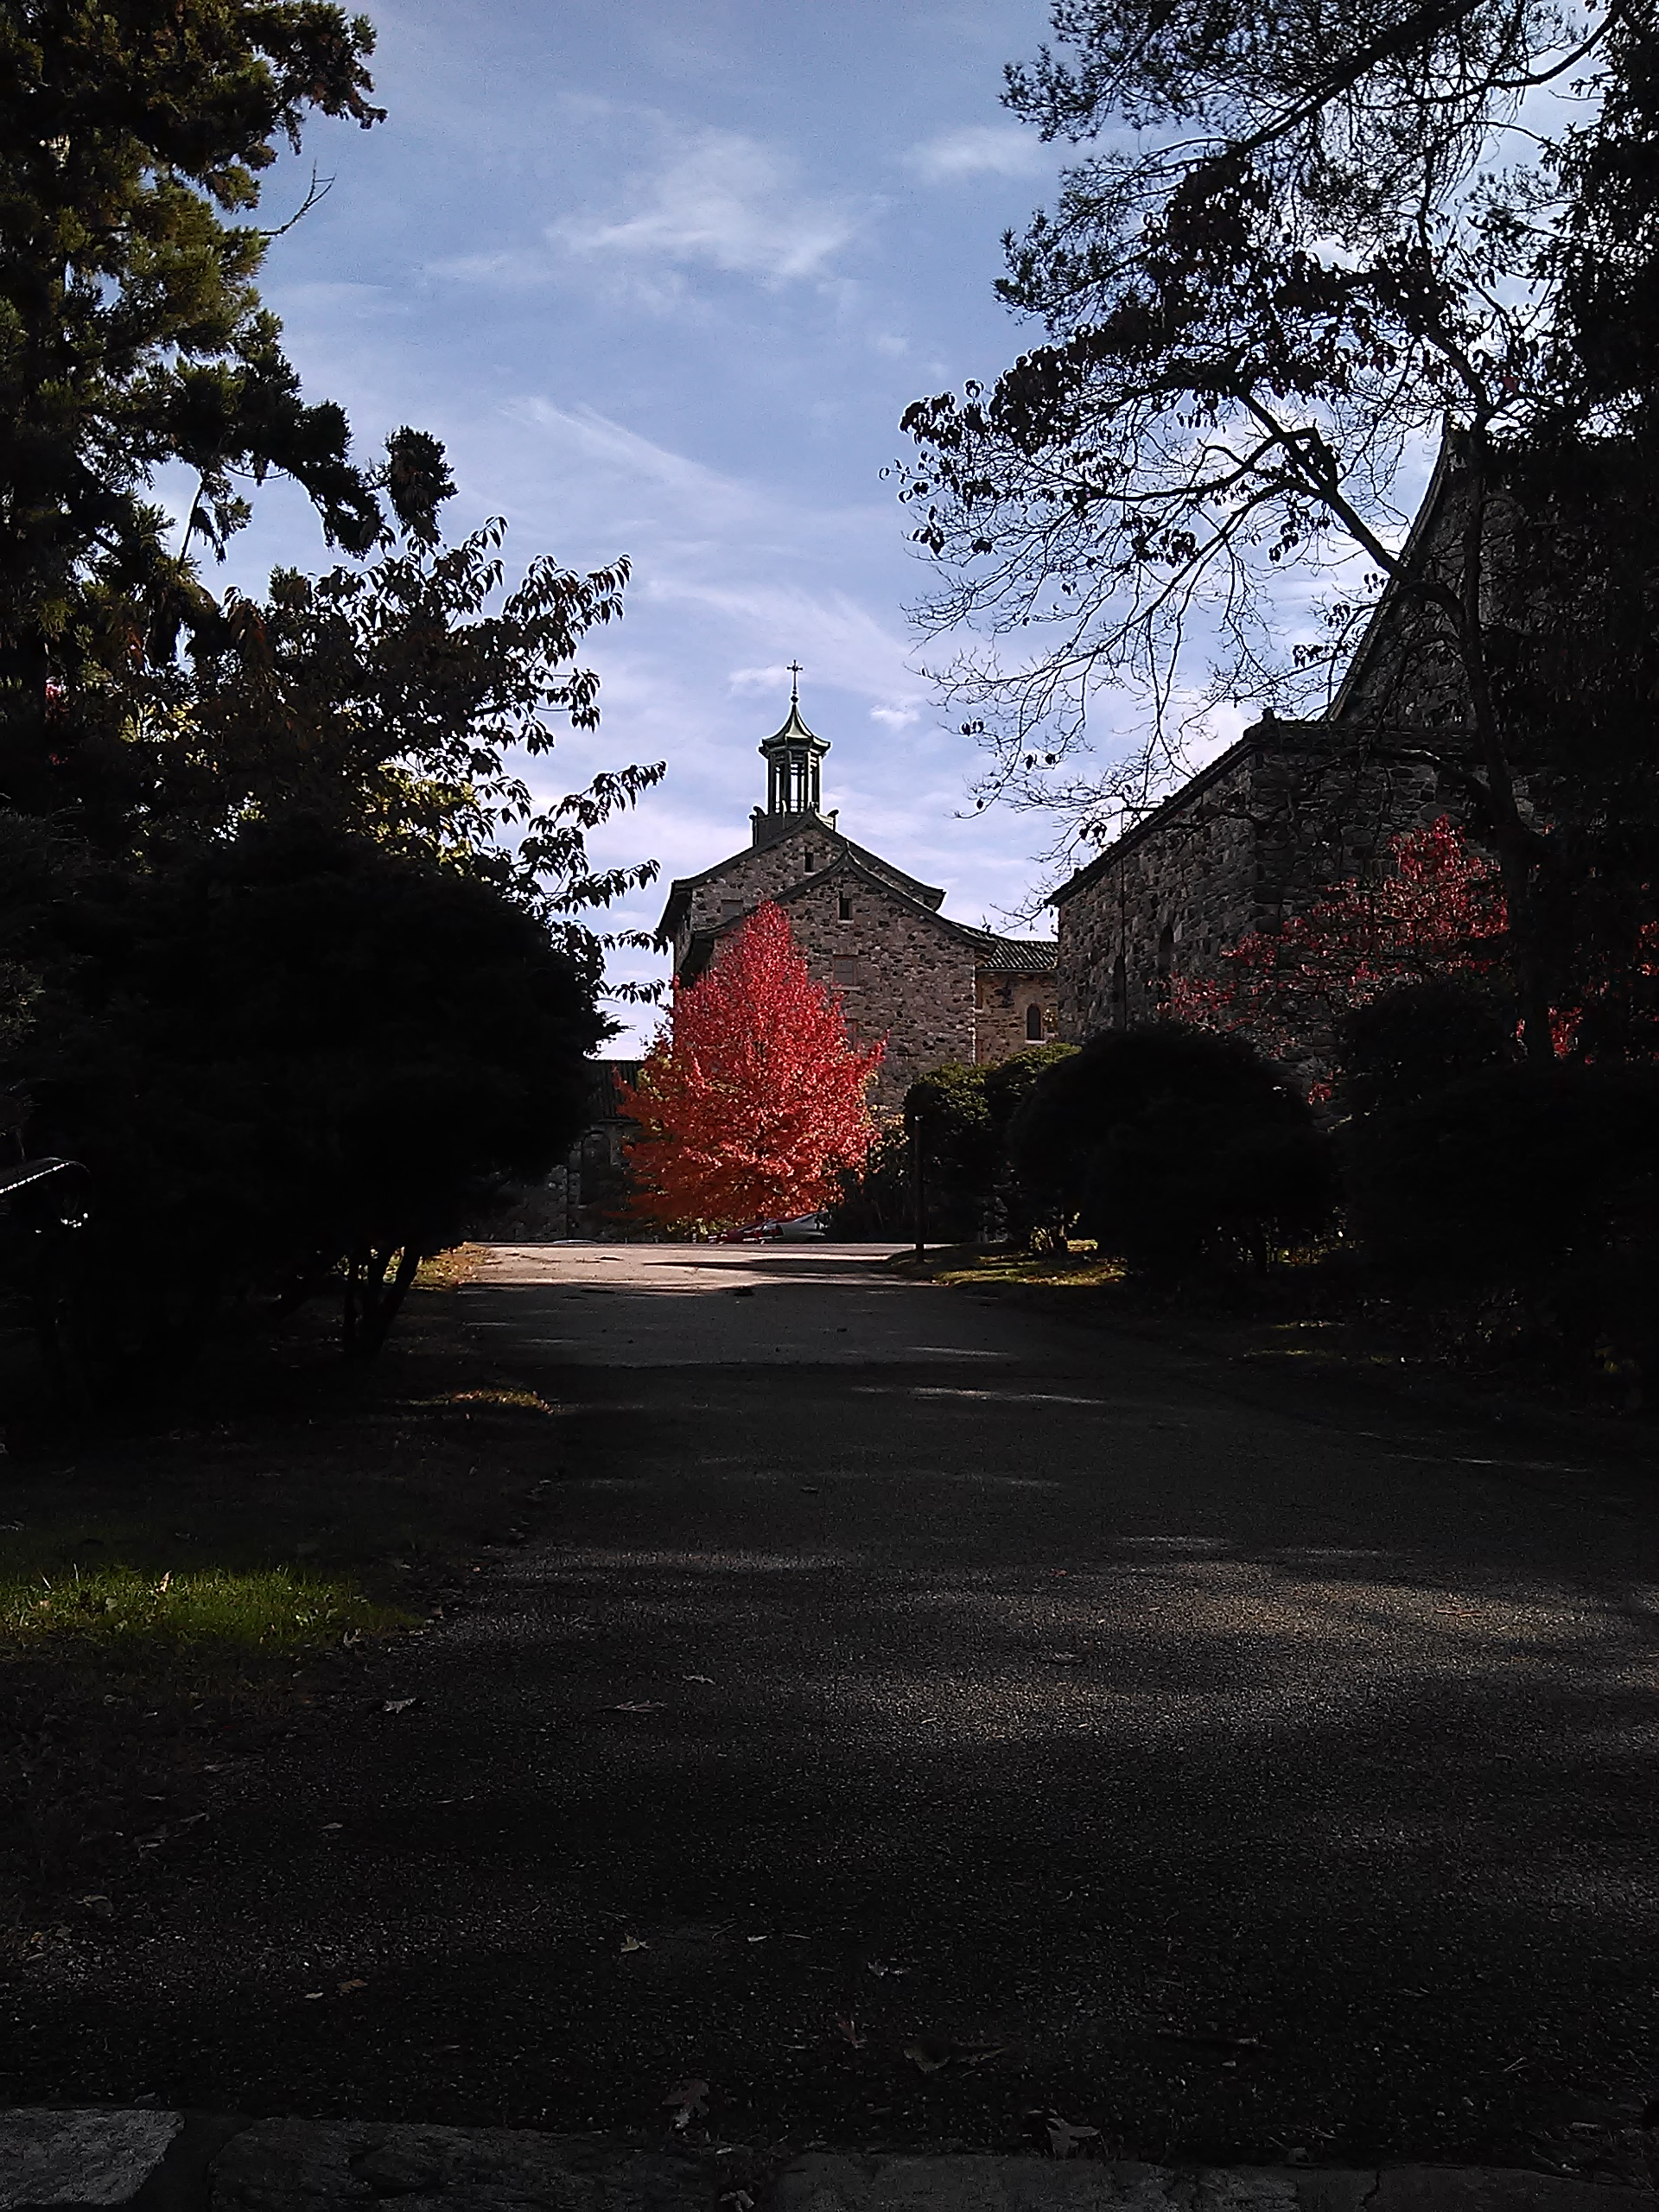
2021 WSC Routine Motions Mociones de Rutina de la CSM 2021
2020 Annual Report Approved
Informe anual 2020 Aprobado
2020 Audit: WSO received unmodified opinion
Auditoría 2020: la OSM recibió una opinión sin modificaciones
2021 Budget: Passed
Presupuesto 2021: Aprobado
Notes:
14. In the last few Assemblies, I’ve reviewed the revised 2020 budget and explained how, because of generous member contributions and cuts in expenses (like WSO staff operating at 80% capacity, no staff travel, etc.) WSO ended the year with a $509,000 surplus. (:30)
{Running total: 22:25}

Slide 15
WSO 2020 Sources of Revenue Fuentes de ingresos de la OSM 2020
Contribuciones 60%
Literatura 34%
Ingresos por
inversiones 1%
Notes:
15. This pie chart shows the breakdown of WSO revenue in 2020. Here you can see how member contributions surpassed literature sales for the first time in decades.
In the next few slides, we’ll take a look at the most popular Al-Anon books of 2020.
I was surprised to learn that the bestsellers were highly dependent on language group.
Can anyone guess the two topselling books in English?
(Raise your virtual hand to be called on or type your answer into the chat.) (1:00)
{Running total: 23:25}

Slide 16
Topselling English Books of 2020 Libros de inglés más vendidos de 2020
Notes:
16. #1 How Al-Anon Works
#2 Courage to Change
These are the same two books that sold the most copies in 2019…
This next question is for Spanish members only. Can you guess which two Spanish books sold the most copies last year? Please type your answers into the chat (1:15) {Running total: 24:40}
This next question is for Spanish members. Please raise your hand if you can guess which two Spanish books sold the most copies?
(Click)

Slide 17
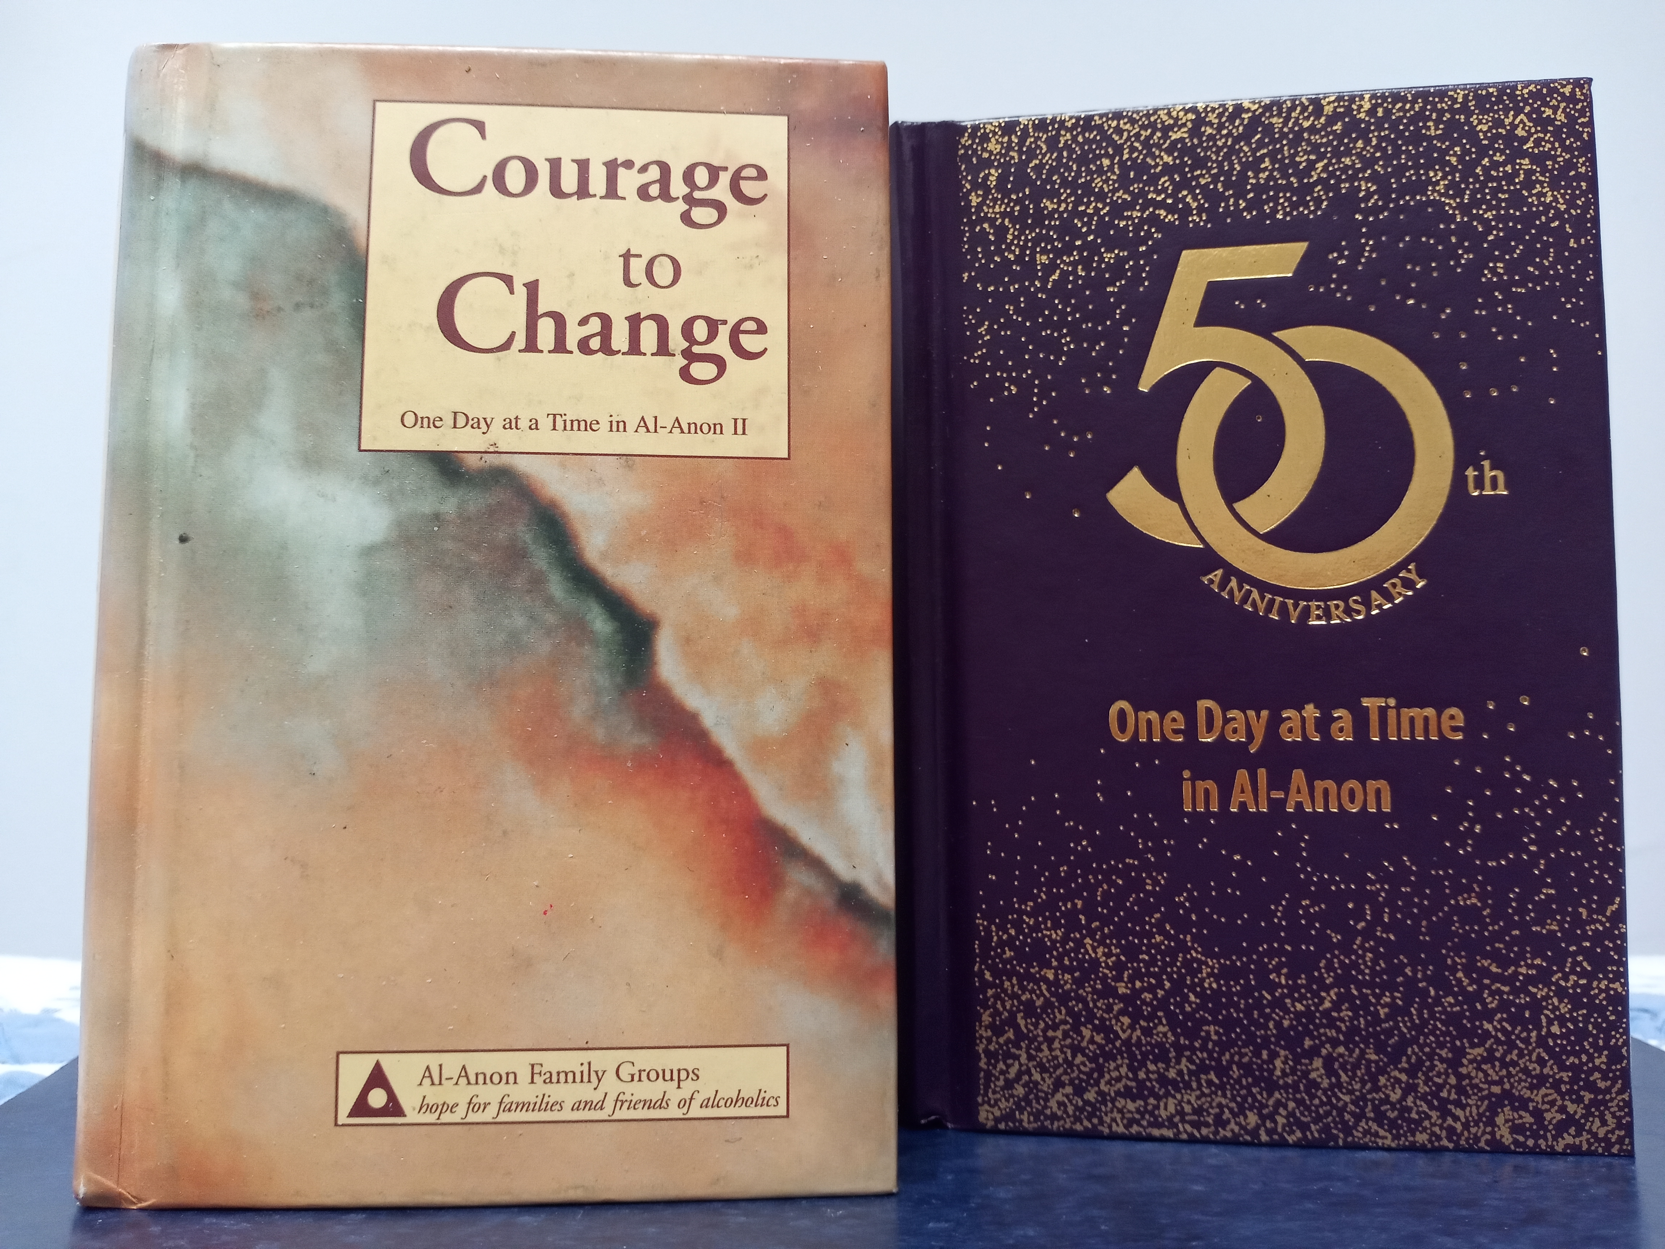
Topselling Spanish Books of 2020 Libros en Español más Vendidos de 2020
Valor para cambiar: Un día a la vez en Al-Anon II (SB-16)
Un día a la vez en Al-Anon (SB-6)
Notes:
17. Courage to Change followed closely by One Day at a Time in Al-Anon, or our ODAT.
…Now, can anyone guess what the topselling book was in French in 2020? (:45)
{Running total: 25:25}

Slide 18
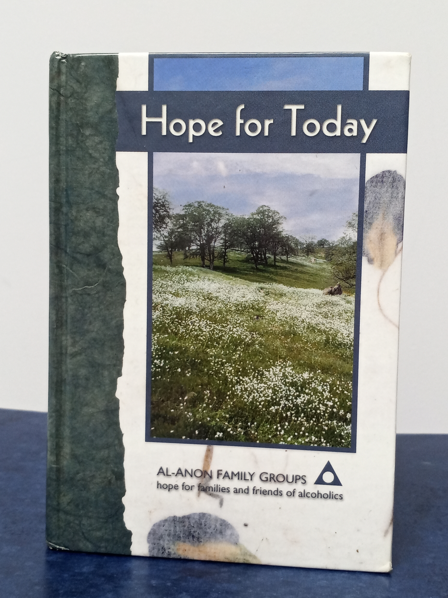
Topselling French Book of 2020 Libro francés más vendido de 2020
De l'espoir pour aujourd'hui (FB-27)
Esperanza para hoy
Third daily reader
with an Adult Child perspective
El tercer lector diario con una perspectiva de niño adulto
Notes:
18. It was Hope for Today, our daily reader with its Al-Anon Adult Child focus. (:10)
{Running total: 25:35}

Slide 19
AFG Headquarters, Inc. 2021 Operating Budget Sede de AFG, Inc. Presupuesto operativo para 2021
2021 Revenue Estimate Actual 2020 Revenue Actual 2019 Revenue
Estimación de ingresos de 2021 Ingresos reales de 2020 Ingresos reales de 2019
Literature Sales: $1.9 Million $1.8 Million $2.9 Million
Contributions: $2.9 Million $3.3 Million $2.2 Million
Other $ 600,000 $ 300,000 $1.2 Million
Total $5.4 Million $5.5 Million $6.6 Million
2021 Expense Estimate Actual 2020 Expenses Actual 2019 Expenses
Estimación de gastos de 2021 Gastos reales de 2020 Gastos reales de 2019
$5.5 Million $5 Million $5.5 Million
Net increase ($ 74,000) $ 509,000 $1.1 Million
/ (decrease)
Notes:
19. Now let’s take a look at the 2021 WSO Budget. These figures are rounded off. Actual amounts can be found in my written report.
As groups continue to meet virtually, literature sales aren’t expected to return to pre-pandemic levels for much of 2021. This reasoning is reflected in the estimated revenue shown here. In 2019, literature revenue was $2.9 million. Last year it dropped to $1.8 million. Projections for 2021 are slightly higher, at $1.9 million.
It’s the opposite for member contributions. Last year, contributions skyrocketed in response to WSO appeals. Contributions went from $2.2 million in 2019 to $3.3 million in 2020. For 2021 the Finance Committee is projecting $2.9 million in contributions, which is $700,000 more than 2019, but $400,000 less than in 2020. It’s hoped that members will continue to be generous with their contributions in order to make up for the difference in literature sales.
For 2021, overall revenue is projected to be on par with that of 2020, but expenses are estimated to be $500,000 higher. The increase in the 2021 expense budget reflects a return to staff and volunteer travel in the second half of this year, and hiring of 4-5 new staff members. (2:00) {Running total: 27:35}

Slide 20
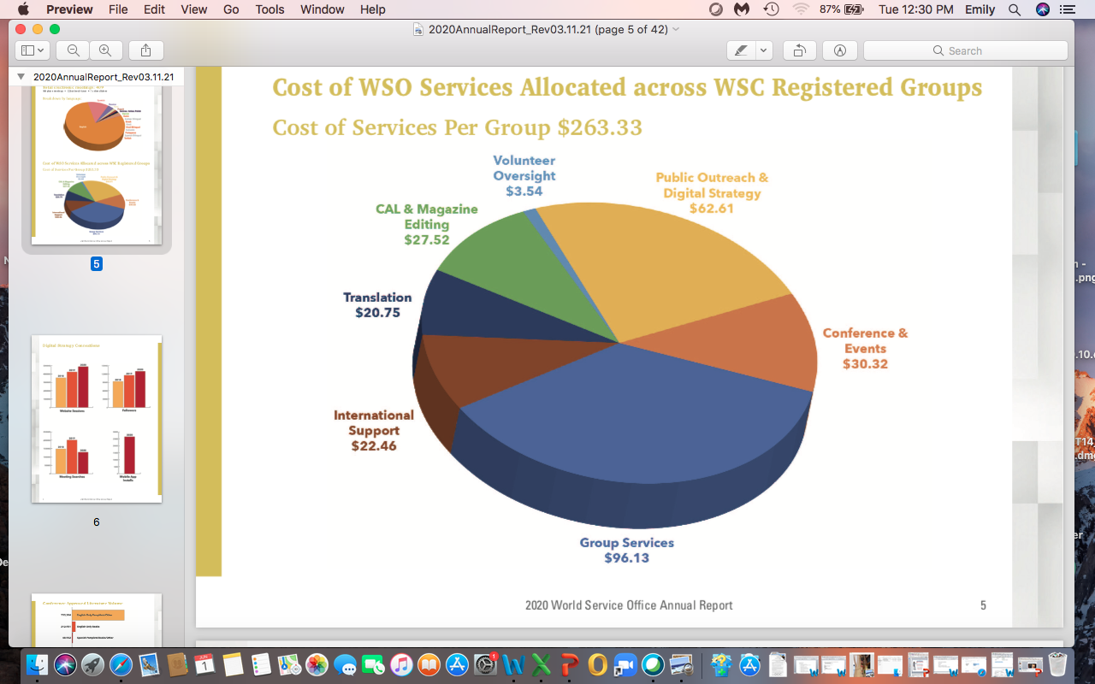
In 2020, where did our WSO contributions go? En 2020, ¿a dónde fueron nuestras contribuciones a la OSM?
In 2020 WSO allocated $263 per group
En 2020, la OSM asignó $ 263 por grupo
Notes:
20. WSO estimated it provided $263 worth of services to each Al-Anon group in 2020
This pie chart shows what our group contributions paid for:
The biggest piece of the pie is blue: Group Services ($96). Public Outreach and Digital Strategy is yellow ($63). Conference and Events is orange ($30); CAL & Magazine editing is green ($28), International Support is brown ($22), and Translation is midnight blue $(21). (:50)
{Running total: 28:25}
The biggest piece of the pie is blue: Group Services ($96). Public Outreach and Digital Strategy is next, in yellow ($63). Conference and Events is orange ($30); CAL & Magazine editing is green ($28), International Support is in brown ($22), and Translation is midnight blue $(21).

Slide 21
2020 Contributions from NY South (Groups & Other) Contribuciones 2020 del Sur de Nueva York (Grupos y Otros)
52% of NYS groups contributed to WSO in 2020
52% de los grupos del Sur de Nueva York contribuido a la OSM en 2020
Average group contribution: $95
Total: $26,000
Contribución grupal promedio: $ 95
Total: $ 26.000
Other NYS contributions (AISs, LDCs & Area):
Total $42,000
Otras contribuciones de NYS (AIS, LDC y Área):
Total $ 42,000
Thank You!
¡Gracias!
Thank you for your generous contributions to WSO in 2020!
¡Gracias por sus generosas contribuciones a la OSM en 2020!
Notes:
21. Here’s a breakdown of contributions that were made from groups and service structures in NY South:
52% of NYS groups contributed to WSO in 2020
NYS Group Contributions totalled $26,000
Average group donation was $95, a little more than half of what WSO estimates spending on each group
Contributions from NYS AISs, Literature Distribution Centers & our Area totaled $42,000 (:45) {Running total: 29:10}

Slide 22
Are there any questions? ¿Hay alguna pregunta?
Notes:
22. Are there any questions on the Finance portion of my report? English speakers please raise your hand, and Spanish speakers may type your question in the chat (:15 plus 8 minutes) {Running total: 37:25}
Now we’ll take a two-minute break for the interpreters. When we return, we’ll move into our breakout session. (:30 plus 2:00) {Running total: 39:55 mins}

Slide 23
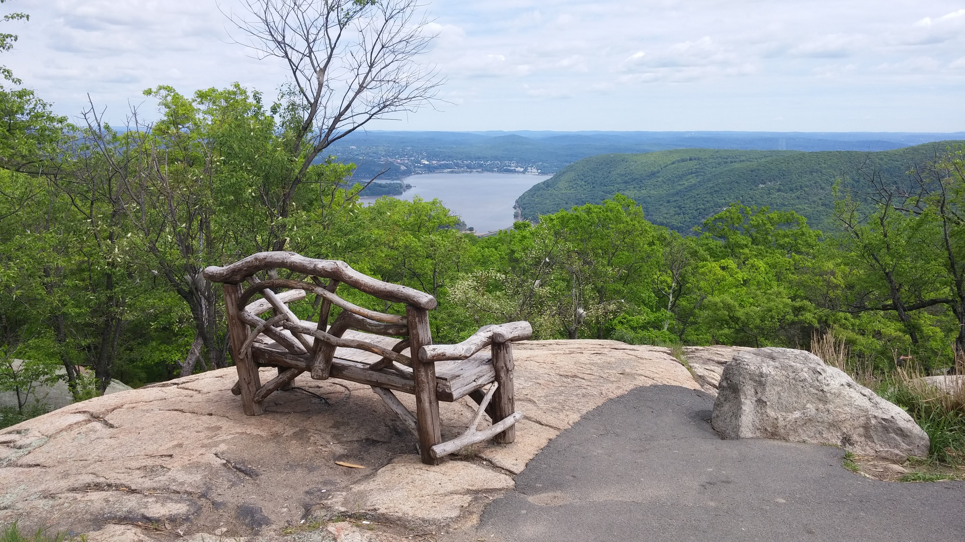
Two Minute Break Descanso de Dos Minutos
Photo by Debbe / Foto de Debbe
Notes:
23. This is another beautiful photo by Debbe. (:05) {Running total: 40:00}

Slide 24
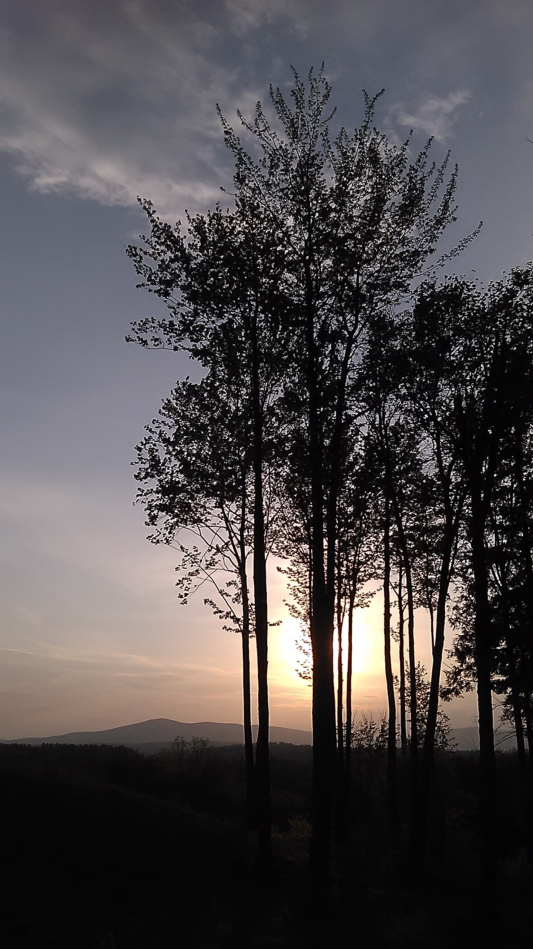
I. Important Discussion Topics at WSC I. Temas de Debate Importantes en la CSM
Time to Talk Topics
Temas para discutir
Group Inventories in a Virtual World
Inventarios de grupo en un mundo virtual
Share your hybrid assembly, hybrid district meeting and/or AFG meeting experiences
Comparta sus experiencias en la asamblea híbrida, reunión de distrito híbrida y / o en las reuniones de GFA
Returning to face-to-face meetings: Looking for experience, strength and hope
Regresar a las reuniones presenciales: Buscando experiencia, fortaleza y esperanza
Notes:
24. During Conference we talked about some topics that had come up in our AFG Connects Community in the past year: Virtual group inventories, hybrid meetings, and returning to meeting face-to-face were the three selected for our Time to Talk session. (:20)
{Running total: 40:20}

Slide 25
Virtual, hybrid, or face-to-face meetings: Reuniones virtuales, híbridas o Beginning the conversation presenciales: Inicio de la conversación
Cuarta Tradición: Cada grupo debiera ser autónomo, excepto en asuntos que afecten a otros grupos o a Al-Anon, o AA en su totalidad.
Preguntas de discusión
Ahora que es más seguro reunirse en un lugar cerrado, ¿qué le gustaría hacer a su grupo?
¿Ha hablado de los pros y los contras de seguir reuniéndose virtualmente?
¿De volver a las reuniones presenciales?
¿De adoptar reuniones híbridas ?
Cuestiones a considerar en reuniones híbridas
¿Nuestro lugar nos dará la bienvenida nuevamente? ¿Nuestro espacio tiene capacidad wifi? Si no es así, ¿podríamos cambiarnos a uno que sí lo tenga?
B. Para reuniones simultáneas (virtuales y presenciales), ¿cómo se manejarán las reuniones de grupo/ decisiones de conciencia de grupo?
C. ¿Qué tradiciones, conceptos y principios de Al- Anon pueden guiar nuestras decisiones?
Tradition Four: Each group should be autonomous except in matters affecting another group or Al-Anon or AA as a whole
Discussion Questions
Now that it’s safer to meet indoors, what would your group like to do?
Have you discussed the pros and cons of continuing to meet virtually?
Of returning to face-to-face meetings?
Of converting to a hybrid format?
Things for hybrid meetings to consider
Will our venue welcome us back? Does our space have wifi capabilities? If not, could we move to one that does?
For simultaneous virtual and in-person meetings, how will business meetings / group conscience decisions be handled?
What Traditions, Concepts, and Al-Anon principles can guide our decisions?
Notes:
25. In a moment, you’ll be asked to join a breakout room to discuss your thoughts about Virtual, Hybrid, or returning to Face-to-face meetings.
There will be 1-2 breakout rooms for Spanish members. And English members will be randomly assigned to rooms. Once there, please choose a GR to facilitate the discussion, and a recorder to report back to the main meeting. Here are the discussion questions: They’ve also been posted to the google drive, and a link is being placed in the chat.
Before we move into our rooms, are there any questions? (1:10 plus 2:00 for questions)
{Running total: 43:30}
Plus 15.00 for breakout rooms = 58:30 mins}
Time for sharing:
Will the recorders please raise your hands in the chat so you can be called on to share? Keep your comments to 1-2 minutes; you’ll receive a gentle warning from our timekeeper. (20:20)
{Running time 1 hour: 18:50 mins. / 78:50 minutes}

Slide 26
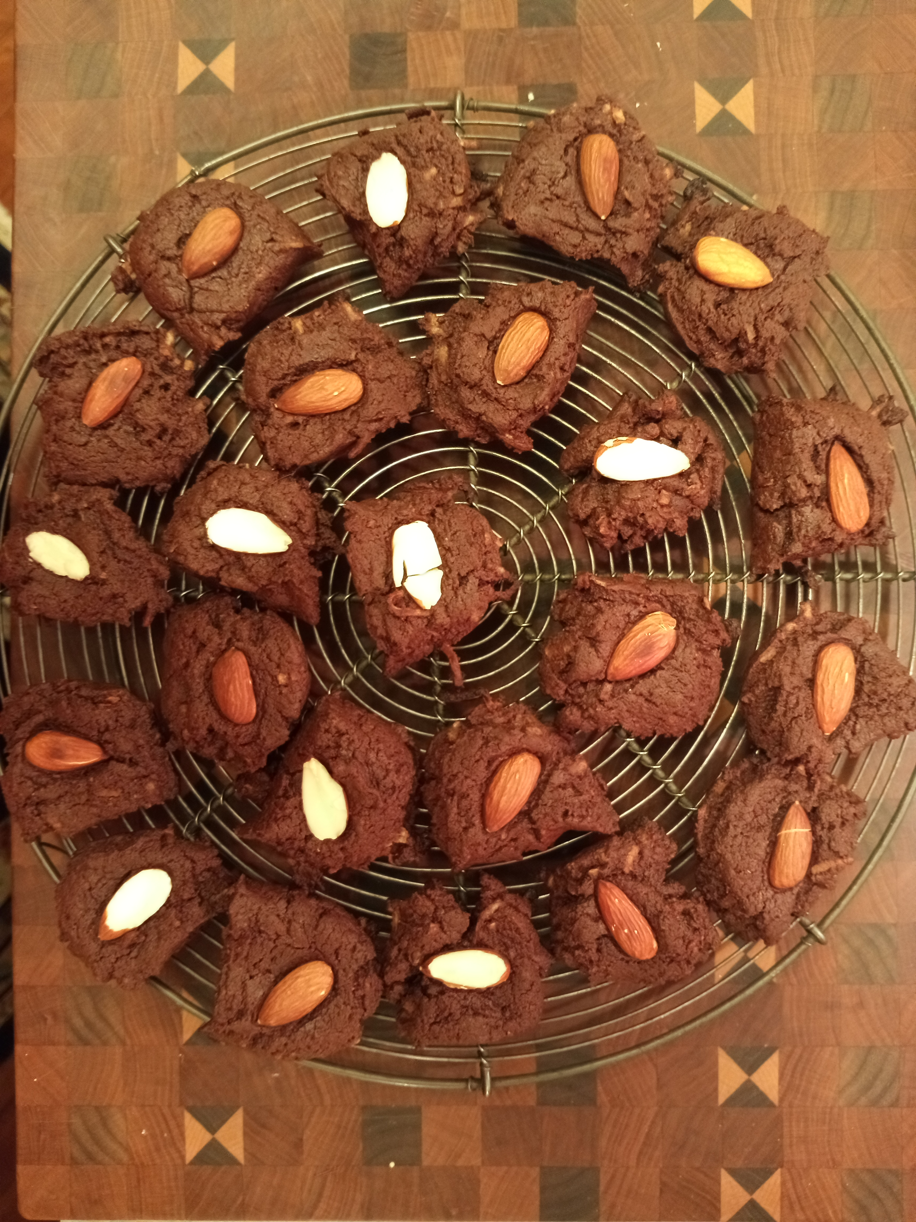
II. Important Discussion Topics at WSC II. Temas de debate importantes en la CSM
Board of Trustees Chosen Agenda Item: Diversity Today: What Does Diversity Mean?
Punto de la agenda elegido por la Junta de Administradores: Diversidad hoy: ¿Qué significa diversidad?
Board Mega Issue:
How can we encourage and support members to share their talents and expertise on the Board of Trustees?
Asunto más importante de la Junta: "¿Cómo podemos alentar y apoyar a los miembros para que compartan sus talentos y experiencia en la Junta de Administradores?"
Notes:
26. The Board of Trustees posed two discussion topics at Conference.
The first was: Diversity Today: What does diversity mean?” They went on to say, “In this context, we can define diversity as understanding that each individual is unique. Diversity embraces varying abilities, belief systems, cultures, ethnicity, gender (including sexual identity and orientation), languages, thought process, and socioeconomic status.
“Because alcoholism affects people from all walks of life, respecting and acknowledging these differences as we come together for our common welfare can present challenges. Within the confines of Tradition One, how can we value and adapt to today’s diverse population? Are we evolving and growing in our interactions with others allowing for the creation of a more inclusive environment?”
Needless to say, we had a very involved and fascinating discussion. This topic will be further explored through a Thought Force I’m chairing for the 2022 WSC. Stay tuned!
The Board’s Mega Issue was, “How can we encourage and support members to share their talents and expertise on the Board of Trustees?” The trustees provide a tremendous service to our fellowship, and because of principle of rotation, members who have served at the Area level and have at least ten years in Al-Anon are encouraged to apply to be a RT or TAL. From what I’ve heard from trustees’ shares, the spiritual rewards of being a trustee are indescribable! (2:00) {Running time: 3:30}

Slide 27
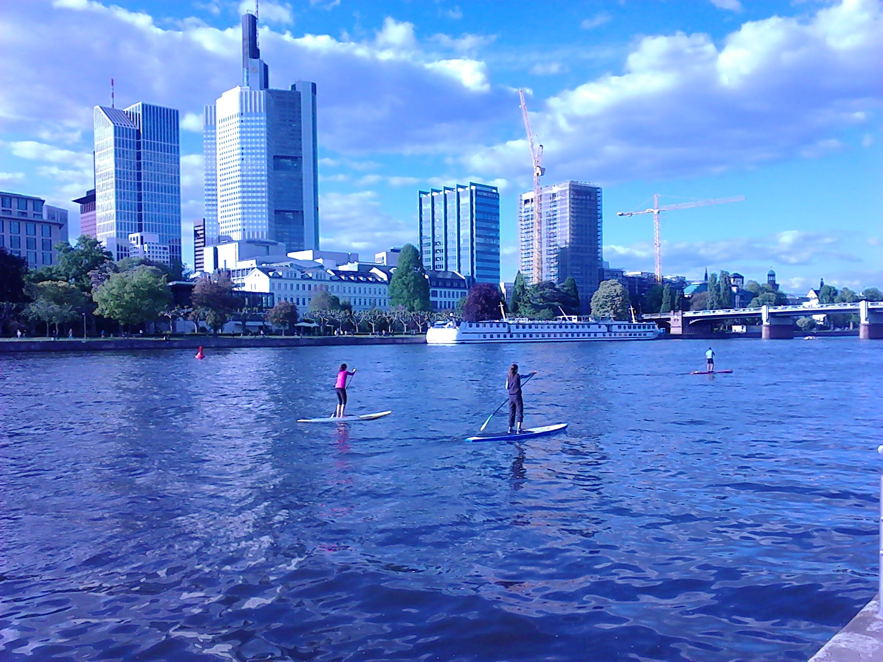
III. Important Discussion Topics at WSC III. Temas de Debate Importantes en la CSM
WSC Members’ Chosen Agenda Items:
Puntos de la agenda elegidos por los miembros de la CSM:
Newcomers in a virtual world—
How can we service them?
Los recién llegados en un mundo virtual: ¿cómo podemos ayudarlos?
2. How does AFG, Inc. maintain the
relevancy of the links of service in a time of increased and accessible electronic information?
¿Cómo GFA, Inc. mantiene la importancia de los enlaces de servicio en una época donde la información electrónica es mayor y más accesible?
Notes:
27. You may remember in January, we co-hosted a Chosen Agenda Items workshop in which members of NY South and New Mexico/ El Paso suggested topics they’d like discussed at the WSC.
From all the topics submitted by Conference members, two were selected.
The first: “Newcomers in a virtual world—How can we service them?” was one of the questions suggested in our workshop.
And here’s the second one: “How does AFG, Inc. maintain the relevancy of the links of service in a time of increased and accessible electronic information?”
When there’s more time, it would be interesting to explore both of these topics.
Next I’ll share briefly on three Thought Force and Task Force presentations that we had. (1:00)
{Running time: 4:30}

Slide 28
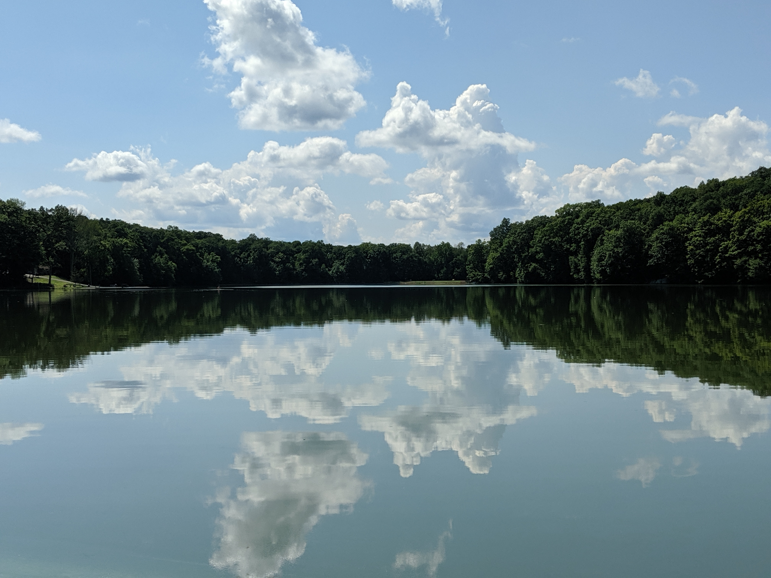
Dreaming Big: Envisioning our Future Soñando en grande: Imaginando nuestro futuro
f
Photo by Debbe / Foto de Debbe
Notes:
28. Dreaming Big: Envisioning our Future was a visionary thought force that I worked on this year. This presentation could help our Area be more intentional about our goals for the future. (:15) {Running time: 4:45}

Slide 29
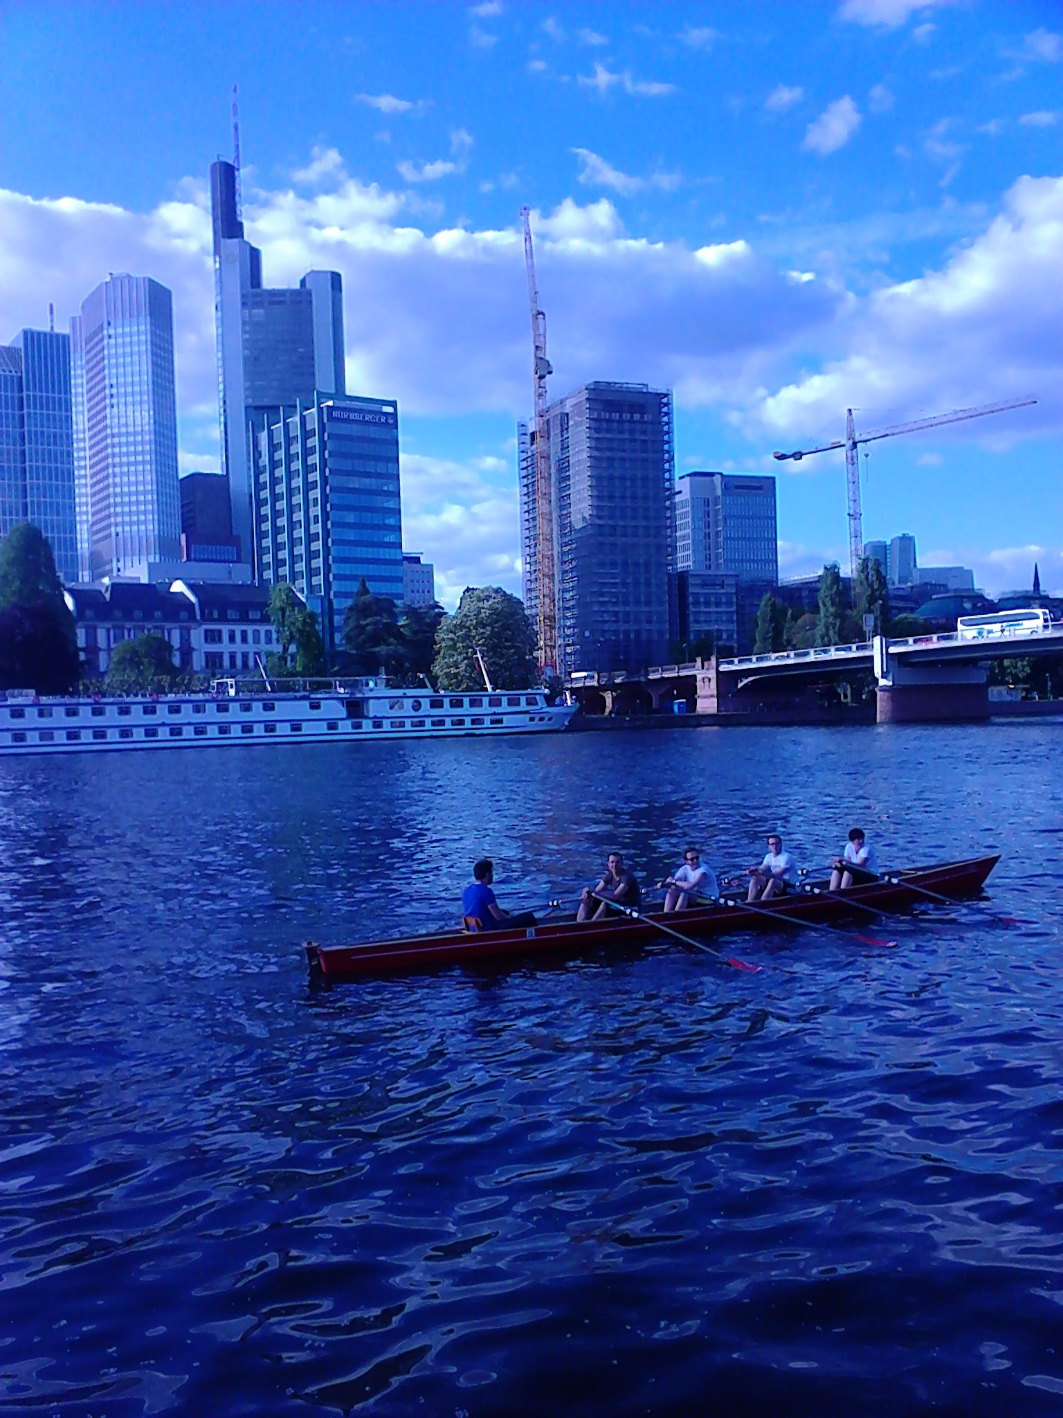
Conflict Resolution Task Force 2021 Grupo de trabajo: Talleres de resolución de conflictos
What: Use the wisdom of Al-Anon principles found in the Conflict Resolution Kit and Concept Five to have a loving interchange regarding conflicts.
Qué: Utilice la sabiduría de los principios de Al-Anon que se encuentran en el Paquete de Resolución de Conflictos y el Concepto Cinco para tener un intercambio amoroso con respecto a los conflictos.
How: Through Workshops, Panel Discussions, and Skits
Cómo: a través de talleres, paneles de discusión y dramatizaciones
Notes:
29. Using three CAL pieces on Conflict Resolution this task force came up with three workshops to help explore and work through conflicts in groups, districts, and Areas. If anyone would like to use this material to help resolve a conflict, please get in touch with me. (:25)
{Running time: 5:10}

Slide 30
Twelve Concepts of Service in our Personal Lives Los Doce Conceptos del Servicio en nuestra vida personal
The Twelve Concepts of Service
Al-Anon’s best
kept secret?
Lo mejor de Al-Anon ¿secreto guardado?
Notes:
30. Using CAL resources, this task force created a colorful PowerPoint presentation with personal sharings on each of the Twelve Concepts, from a sports team perspective. They wrote: “This Concept Camp is meant to be used in a meeting or Assembly to go through the Concepts of Service in our personal recovery at home, work, and in groups other than Al-Anon groups.”
It would be fun to show this PowerPoint at another Assembly, or at a district or Area event! Please let me know if you’re interested. (:30) {Running time: 5:40}

Slide 31
2021 Membership Survey & Longitudinal Study Encuesta Para los Miembros y Estudio Longitudinal de 2021
I. Trilingual 2021 Membership Survey:
June 16, 2021 to July 27, 2021
al-anon.org/membersurvey
Encuesta para los miembros trilingüe:
16 de junio de 2021 al 27 de julio de 2021:
al-anon.org/encuestamiembros
II. Five-year Longitudinal Study if you opt in when you take the Membership Survey
Estudio longitudinal de cinco años si opta
por participar cuando realiza cuando la encuesta para los miembros
Please announce in your groups
Por favor anuncie en sus grupos
Important for Spanish members to fill out 2021 survey, as they were under-represented in 2018.
Es importante que los miembros españoles completen la encuesta de 2021, ya que estuvieron infrarrepresentados en 2018.
We all need to be counted!
¡Todos necesitamos ser contados!
Notes:
31. Before we end, I’d like to talk about the triannual 2021 Membership Survey, which will be available from June 16th to July 27, 2021 on the WSO website in English, Spanish and French. The web address is listed on this slide: al-anon.org/membersurvey; al-anon.org/encuestamiembros
All Al-Anon members are encouraged to participate in the 2021 Membership Survey.
Please announce it in your groups. It’s especially important for Spanish members to fill out the survey, as they were under-represented in 2018. And we all need to be counted!
This year, there’s an exciting opportunity to participate in an Al-Anon research project. Conference Members approved a five-year Longitudinal Study, to begin this summer.
Here’s how it works: When you fill out the 2021 Membership Survey, you can opt in to the Longitudinal Study. Participants who sign up will be selected at random. Once a year you’ll be contacted via email by a WSO staff member and asked a set of ten questions, the same ones each time, for a period of five years from 2022 through 2026. All data is anonymous, but it will provide invaluable information on the benefits of sustained membership in Al-Anon. This evidence-based study will appeal to researchers and writers, and to professionals who are more likely to recommend Al-Anon to their clients.
(1:40) {Running total: 7:20 }

Slide 32
WSO News & Updates Noticias de la OSM
WSO Online Store Update
Electronic Welcome Packet (eK-10)
Al-Anon’s 70th Anniversary
Save the Date—Road Trip! 2021
Literature: New Daily Reader
2023 Al-Anon International Convention: Albuquerque, NM,
June 29 – July 2, 2023
Actualización de la tienda en línea de la OSM
Paquete de bienvenida electrónico (eK-10)
Al-Anon cumple 70 años en 2021! Reserve la fecha: ¡viaje por carretera! 2021
Literatura: Nuevo Libro de Lectura Diaria
Convención Internacional de Al-Anon 2023 en Albuquerque, NM, del 29 de junio al 2 de julio 2023
Albuquerque!
Notes:
32. I’d like to share some other news and updates:
1. The WSO Online Store has now been updated at al-anon.org: It’s fully trilingual and can be accessed on a variety of devices
2. The electronic welcome packet is available to order. Search for Welcome Newcomer! (eK-10) in the online store, and it will take you to a list of authorized vendors.
3. This is Al-Anon’s 70th Anniversary year! Various service arms are organizing celebrations. NYSA might consider hosting a virtual celebration, too.
4. Save the Date—for Road Trip! 2021 will be held in Cleveland, Ohio on Oct. 23rd – This is our chance to meet the Board of Trustees.
5. Literature: New Daily Reader is still on target to be released in all three languages at the 2023 Al-Anon International Convention
6. The Convention will be held in Albuquerque, NM from June 29 - July 2nd in 2023. I’m definitely going and I hope you’ll join me! (1:50) {Running time: 8:10}

Slide 33
2022 WSC will be held in New York South! ¡La CSM 2022 se llevará a cabo en el Sur de Nueva York!
Notes:
33. The 62nd WSC will take place April 26 - April 30, 2022. Delegates will arrive at the Westchester Marriott in Tarrytown, New York on Monday, April 25, and depart Sunday, May 1. I hope we can give WSC members a warm New York South welcome! Please let me know if you have ideas. (:30) {Running time: 8:40}

Slide 34
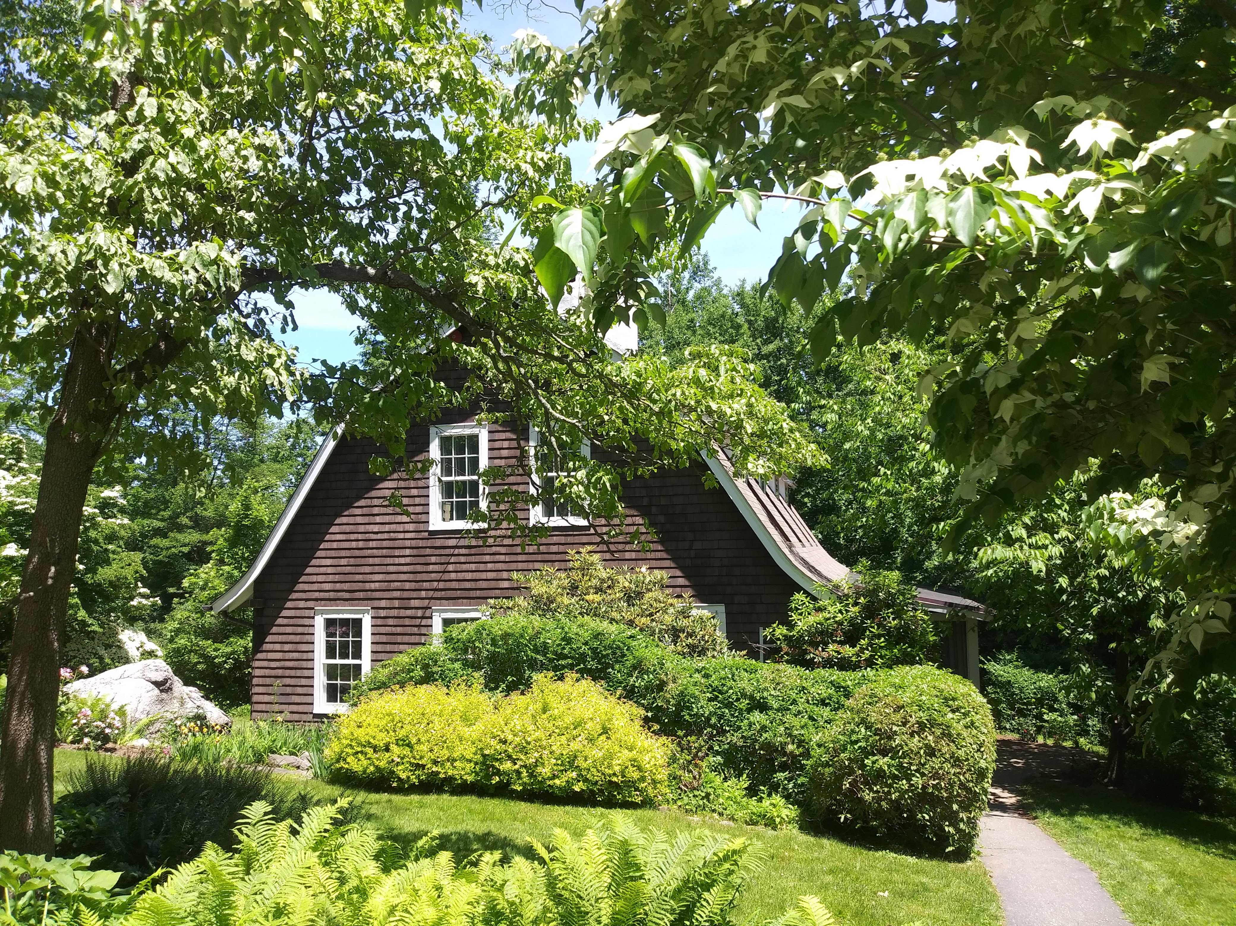
In Closing… Para concluir…
Photo by Tom C. / Foto de Tom C.
Notes:
34. This was an amazing Conference! So different from last year. The agenda was extra full because the Literature and Policy Committee proposals were tabled when we converted to a Virtual Conference in 2020.
We accomplished so much, and the tone throughout was one of unity and goodwill.
Besides business, it was a full Conference experience, with Panel 59 Delegate talks; Trustee and volunteer sharings; and a moving virtual visit to Stepping Stones. At the end, we were entertained by an hilarious skit that Panel 59 Delegates created--complete with time travel and singing, as the outgoing Delegates bid us “So long, farewell, auf weidersehn, goodbye,” from the Sound of Music. It was so touching.
Next year, I look forward to meeting in person for my first and last chance to experience Conference as it was meant to be—with all the hugs, shared meals, fellowship, and an actual trip to Stepping Stones! It will take the better part of a year to absorb all we did in one packed week. I hope I was able to convey just a small portion of it to you today. (1:20) {Running time: 10:00}

Slide 35
More Information: al-anon.org/Members/WSC Summary/Highlights of the WSC Por Mas Information: al-anon.org/Miembros/CSM
Questions?
¿Preguntas?
nys60delegate@gmail.com
Notes:
35. Are there any questions? English members can raise your hands, and Spanish members please type your questions into the chat.
A four-page summary of the 2021 WSC is now available at al-anon.org. Hover over the Members tab and select WSC -- Summary/Highlights of the WSC. As mentioned, the complete 2021 WSC Summary will be available online in July.
For further questions after the Assembly, my e-mail address appears on this slide: nys60delegate@gmail.com (:40 plus 8:00 minutes) {Running time: 18:40}

